Slide 1

Area Between Two Curves

Slide 2

In this sequence we review and extend the use of definite integrals to represent plane areas.
Recall that the integral
$\int_{b}^{a}{f\left(x\right)dx}$
measures the area between the graph of $f$ and the $x−$axis from $x=a$ to $x=b$, but treats as negative any part of this area that lies below the
$x−$axis. (We are assuming that $a<b$.)

Slide 3
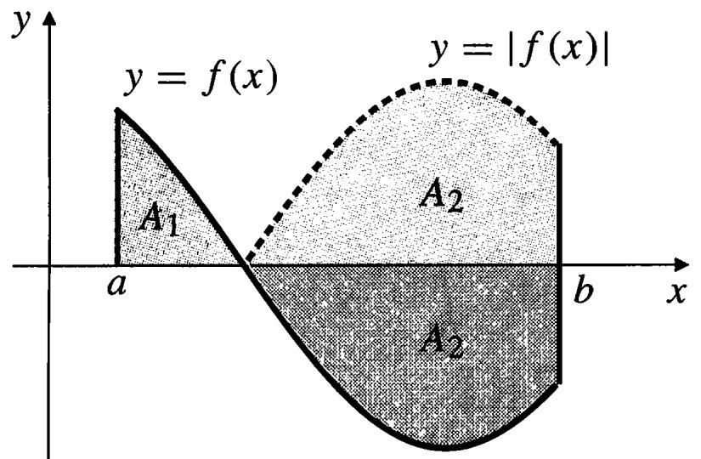

In order to express the total area bounded by $y=f(x)$,$y=0$ ,$x=a$, and $x=b$, counting all of the area positively, we should integrate the absolute value of $f$(see the figure below):
$\int_{b}^{a}{f\left(x\right)dx}=A_{1}−A_{2}$
and
$\int_{b}^{a}{\left|f(x)\right|dx}=A_{1}+A_{2}$.

Slide 4

There is no rule for integrating
$\int_{b}^{a}{\left|f(x)\right|dx}$
one must break the integral into a sum of integrals over intervals where $f\left(x\right)>0$ so $\left|f(x)\right|=f(x)$, and intervals where $f\left(x\right)<0$ so $\left|f(x)\right|=−f(x)$.
To find the area between the graph of $f$ and the $x−$axis over the interval $[a,b]$:
  Subdivide $[a,b]$ at the zeros of $f$.
  Integrate $f$ over each subinterval.
  Add the absolute values of the integrals.

Slide 5
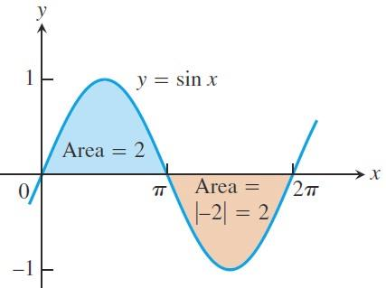

Example: The figure below shows the graph of the function $f\left(x\right)=\sin{x}$ between $x=0$ and
$x=2π$. Compute the area between the graph of and the $x−$axis over $[0,2π]$.
Solution: First find the zeros of $f$. On $[0,2π]$,
the zeros of $f\left(x\right)=\sin{x}$ are $x=0 , π , 2π$.

Slide 6

So, the area between the graph of $f(x)$ and the $x−$axis over $[0,2π]$ is calculated by breaking up the domain of $\sin{x}$ into two pieces: the interval $[0,π]$ over which it is nonnegative and the interval $[π,2π]$ over which it is non positive.
$$\int_{0}^{π}{\sin{x}dx}={\left.−\cos{x}\right]}_{0}^{π}=−\left(\cos{π}−\cos{0}\right)=2$$
$$\int_{π}^{2π}{\sin{x}dx}={\left.−\cos{x}\right]}_{π}^{2π}=−\left(\cos{2π}−\cos{π}\right)=−2$$
The second integral gives a negative value. The area between the graph and the axis is obtained by adding the absolute values
Area $\left|2\right|+\left|−2\right|=4$

Slide 7
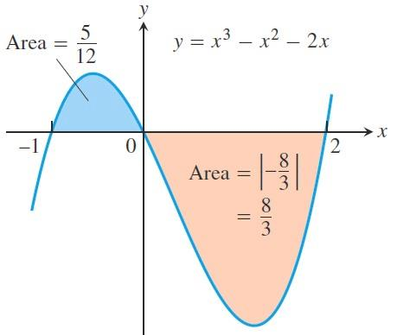

Example: Find the area of the region between the $x−$axis and the graph of $f\left(x\right)=x^{3}−x^{2}−2x$ over $[−1,2]$.
Solution: First find the zeros of $f$. Since
$f\left(x\right)=x^{3}−x^{2}−2x=x\left(x^{2}−x−2\right)=x\left(x−1\right)\left(x+1\right)$
the zeros are $x=0$ ,$−1$ and $2$
(see the figure below).

Slide 8

The zeros subdivide $[−1,2]$ into two subintervals:$[−1,0]$ on which $f(x)≥0$ and $[0,2]$, on which $f(x)≤0$. We integrate $f$ over each subinterval and add the absolute values of the calculated integrals.
$$\int_{−1}^{0}{\left(x^{3}−x^{2}−2x\right)dx}={\left.\frac{x^{4}}{4}−\frac{x^{3}}{3}−x^{2}\right]}_{−1}^{0}=\frac{5}{12}$$
$$\int_{0}^{2}{\left(x^{3}−x^{2}−2x\right)dx}={\left.\frac{x^{4}}{4}−\frac{x^{3}}{3}−x^{2}\right]}_{0}^{2}=−\frac{8}{3}$$
The total enclosed area is obtained by adding the absolute values of the calculated integrals.
$$Area=\left|\frac{5}{12}\right|+\left|−\frac{8}{3}\right|=\frac{37}{12}$$

Slide 9
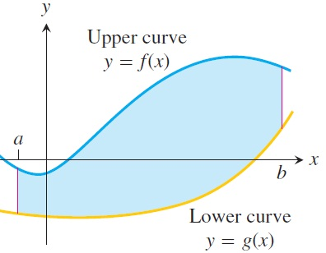
Areas Between Curves: Suppose we want to find the area of a region that is bounded above by the curve $y=f(x)$, below by the curve $y=g(x)$ and on the left and right by the lines $x=a$ and $x=b$ (see figure below). The region might accidentally have a shape whose area we could find with geometry, but if $f$ and $g$
are arbitrary continuous
functions, we usually have to
find the area with an integral.

Slide 10

Definition: If $f$ and $g$ are continuous throughout $[a,b]$, then the area of the region between the curves $f(x)$ and $g(x)$ from $a$ to $b$ is the integral of $\left|f−g\right|$ from $a$ to $b$:
$A=\int_{b}^{a}{\left|f\left(x\right)−g(x)\right|dx}$
When applying this definition it is helpful to graph the curves. It helps you find the limits of integration if they are not given.
You may need to find where the curves intersect to determine the limits of integration, and this may involve solving the equation $f\left(x\right)=g(x)$ for values of $x$.

Slide 11
Then you can integrate the function for the area between the intersections.
Example: Find the area of the region bounded above by the curve $y=2e^{−x}+x$, below by the curve $y=\frac{1}{2}e^{x}$, on the left by $x=0$, and on the right by $x=1$.
Solution: The figure in the next slide displays the graphs of the curves and
the region whose area we want to find.

Slide 12
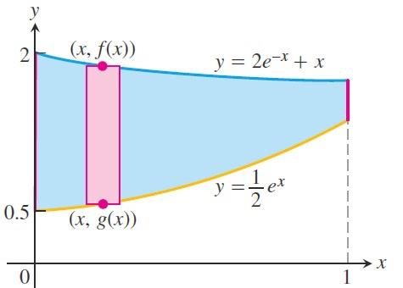
The area between the curves over the interval is given by
$$\int_{0}^{1}{\left|\left(2e^{−x}+x\right)−\frac{1}{2}e^{x}x\right|}={\left.\left|−2e^{−x}+\frac{x^{2}}{2}−\frac{1}{2}e^{x}\right|\right]}_{0}^{1}=3−\frac{2}{e}−\frac{e}{2}≈0.9051$$

Slide 13
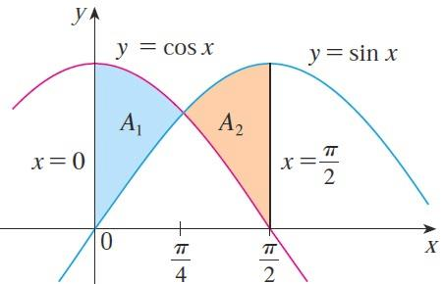
Example: Find the area of the region bounded by the curves $y=\sin{x}$,$y=\cos{x}$ ,$x=0$ , and $x=π/2$
Solution:
The points of intersection occur when $\sin{x}=\cos{x}$, that is, when $x=π/4$ since $0≤x≤π/2$. The intersection point $x=π/4$ subdivide $[0,π/2]$ into two subintervals:
$[0,\frac{π}{4}]$ on which $\cos{x}≥\sin{x}$ and $[\frac{π}{4},\frac{π}{2}]$ ,
on which $\sin{x}≥\cos{x}$.

Slide 14

We integrate $\sin{x}−\cos{x}$ over each subinterval and add the absolute values of the calculated integrals.
$$\int_{0}^{π/4}{(\sin{x}−\cos{x})}={\left[−\cos{x}−\sin{x}\right]}_{0}^{π/4}=1−\sqrt{2}$$
$$\int_{π/4}^{π/2}{(\sin{x}−\cos{x})}={\left[−\cos{x}−\sin{x}\right]}_{π/4}^{π/2}=−1+\sqrt{2}$$
Therefore the required area is:
$$\left|1−\sqrt{2}\right|+\left|−1+\sqrt{2}\right|=2\sqrt{2}−2$$

Slide 15
Thank you for your Attention

