Slide 1

Volumes

Slide 2
In trying to find the volume of a solid we face the same type of problem as in finding areas.
We have an intuitive idea of what volume means, but we must make this idea precise by using calculus to give an exact definition of volume.
The volume of a solid can be obtained by integrating the cross-sectional area from one end of the solid to the other.

Slide 3
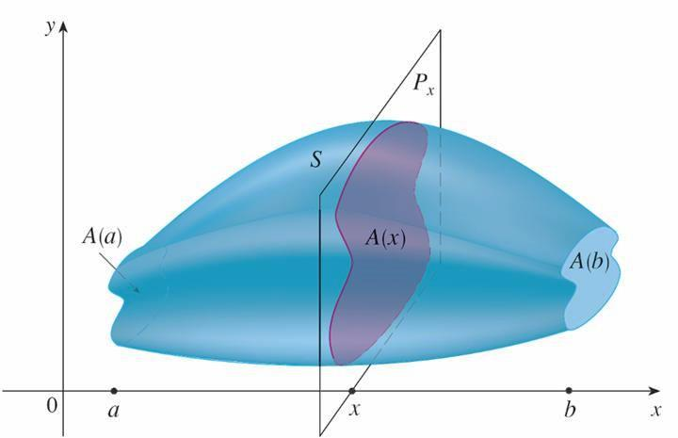

Let $A(x)$ (where $A$ is continuous) be the area of the cross-section of $S$ in a plane $P_{x}$ perpendicular to the $x−$axis and passing through the point $x$, where $a≤x≤b$. Then the volume of $S$ is
$V=\int_{b}^{a}{A(x)dx}$

Slide 4
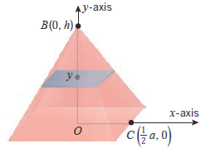

Example: Derive the formula for the volume of a right pyramid whose altitude is $h$ and whose base is a square with sides of length $a$.
Solution: As illustrated in the figure, we introduce a rectangular coordinate system in which the $y−$axis passes through the apex and is perpendicular to the base, and the $x−$axis passes through the base and is parallel to a side of the base.

Slide 5
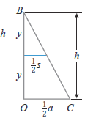

At any $y$ in the interval $[0,h]$ on the $y−$axis, the cross section perpendicular to the $y−$axis is a square.
If $s$ denotes the length of a side of this square, then by similar triangles
$\frac{\frac{1}{2}s}{\frac{1}{2}a}=\frac{h−y}{h} or s=\frac{a}{h}(h−y)$
Thus, the area $A(y)$ of the cross section at $y$ is
$$A\left(y\right)=s^{2}=\frac{a^{2}}{h^{2}}{(h−y)}^{2}$$
and the volume is
$$V=\int_{0}^{h}{A\left(y\right)dy=\int_{0}^{h}{\frac{a^{2}}{h^{2}}{(h−y)}^{2}dy}}=\frac{a^{2}}{h^{2}}\int_{0}^{h}{{(h−y)}^{2}dy}=\frac{a^{2}}{h^{2}}{\left[−\frac{1}{3}{(h−y)}^{3}\right]}_{y=0}^{h}=\frac{a^{2}}{h^{2}}\left[0+\frac{1}{3}h^{3}\right]$$
$$=\frac{1}{3}a^{2}h$$

Slide 6
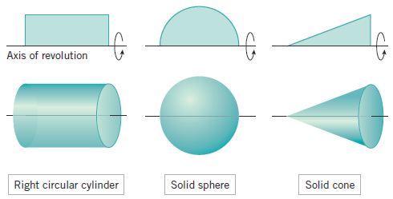
Solids of revolution: a solid of revolution is a solid that is generated by revolving a plane region about a line that lies in the same plane as the region; the line is called the axis of revolution.

Slide 7
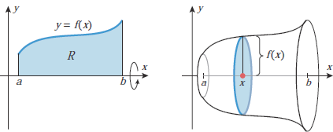

Theorem: Let be continuous and nonnegative on $[a,b]$, and let $R$ be the region that is bounded above by $y=f(x)$, below by the $x−$axis, and on the sides by the lines $x=a$ and $x=b$. The volume of the solid of revolution that is generated by revolving the region $R$ about the $x−$axis is
$V=π\int_{a}^{b}{{\left[f\left(x\right)\right]}^{2}dx}$

Slide 8
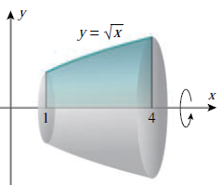

Example: Find the volume of the solid that is obtained when the region under the curve $y=\sqrt{x}$ over the interval $[1,4]$ is revolved about the $x−$axis.
Solution:
$V=π\int_{a}^{b}{{\left[f\left(x\right)\right]}^{2}dx}=\int_{1}^{4}{πxdx}={\left.\frac{πx^{2}}{2}\right]}_{1}^{4}=8π−\frac{π}{2}=\frac{15π}{2}$

Slide 9
Thank you for your Attention

