Slide 1
HOW TO GET THE BEST BENEFIT FROM SCOPUS? For PhD students and Faculty Members
2019

Slide 2
Agenda
Researcher Problems
Importance of Literature Review
Why use Scopus not just Google it?
Abilities of Scopus
Analysis Tools
Finding sources to publish in Scopus
Content Selection
Understanding Research Metrics in Scopus
ScienceDirect Content

Slide 3
Challenges of Researchers
Keeping up with scientific literature – 2.5 million new articles are published each year
Lack of citations received
Finding the right collaborator
Finding the right journal to publish
Finding the relevant one among vast amount of misleading information
Graduation / Recognition and increase reputation
Poor time management
Getting research funding

Slide 4

Research and Publication Process
Writing a paper is a long process; defining a subject area, building the manuscript and publishing may take a period of 1-2 years. For high quality journals this time can be 2-3 years!
Determining the subject area
It must be original, attractive and not too general
It must bring significant advances in the field
It must have clear context and relations with previous work,
Literature Review
Building Hypothesis
Determining the type of article
Writing in English will increase your visibility and metrics!
Reading and searching is the key step in publishing process, use Scopus and ScienceDirect to increase the quality of your publications!

Slide 5
Why use Scopus not just Google it?
Scopus is designed specifically to support search and result handling for scholarly literature
Scopus has only peer-reviewed literature from bona-fide sources
It has the broadest coverage of any database, and we know exactly what is in it
Consistency and transparency : No mystery: every results can be explained by the search you did and what is in the content
It uses technology in a broader level : you can get more information by using related documents and recommendations

Slide 6

HOW CAN SCOPUS HELP YOU ACHIEVE BETTER RESULTS?

Slide 7
Brief Refreshment on Scopus
The largest abstract and citation database of peer-reviewed literature, and features smart tools that allow you track, analyse and visualize scholarly research
*Records back to 1788
*Over 8.000 ‘article in press’
*Over 4.000 active Gold Open Access journals are indexed
*Additional enhanced metadata, i.e. 100% Medline coverage
*Database is updated daily
*40 different languages are covered
*Automatically generated researcher and affiliation profiles
+70 Million Multiple regional content types from more than 6.000 publishers and 105 countries
JOURNALS
CONFERENCES
BOOKS
PATENTS*
Physical
Sciences
23,507 peer-reviewed journals
301 trade journals
Full metadata, abstracts and cited references (refs post-1970 only)
Funding data from acknowledgements
Citations back to 1970
106K conference events
8.3M conference papers
Mainly Engineering and Computer Sciences
613 book series
38K volumes
166K stand-alone books
1.5M items
27M patents
From 5 major
patent offices
- WIPO
- EPO
- USPTO
- JPO
- UK IPO
Health
Sciences
Social
Sciences
Life
Sciences
Source: Scopus.com, January 30, 2018

Slide 8
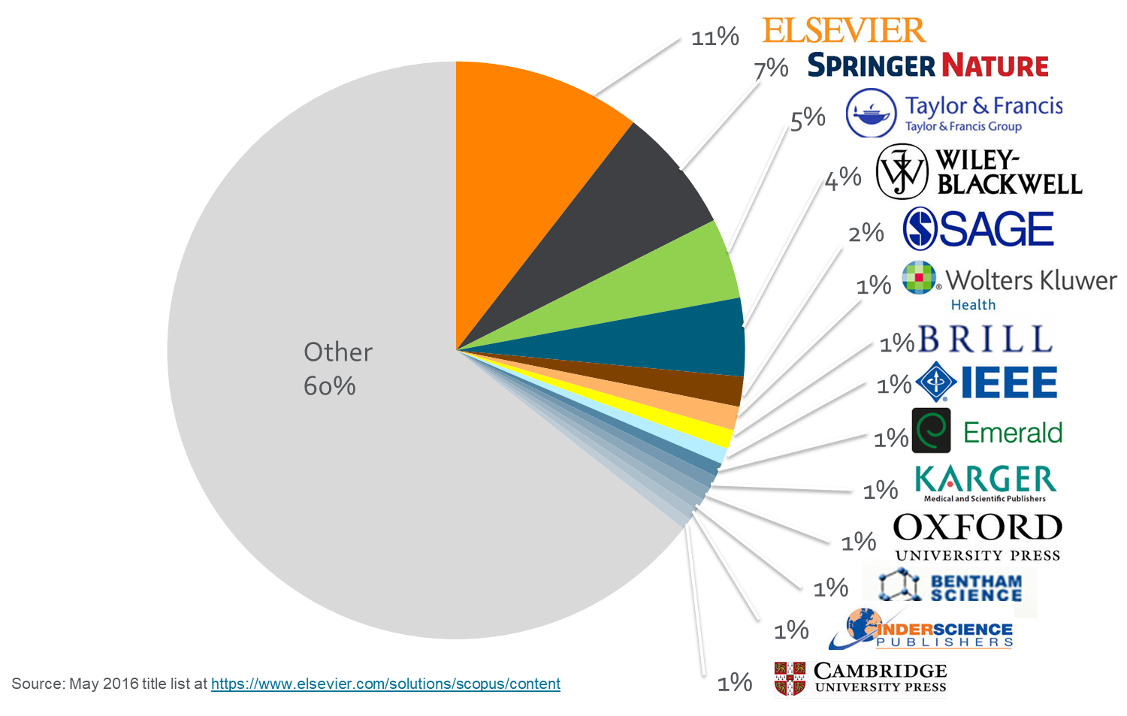
Publisher Coverage

Slide 9
Subject Coverage
Titles on Scopus are classified under 4 subject clusters and indexed into 27 main subject areas:
Life Sciences
6,809 titles
Physical Sciences
12,263 titles
16%
28%
25%
Social Sciences
10,905 titles
31%
Health Sciences
13,819 titles
* Includes active titles. Titles may fall into more than one subject area

Slide 10
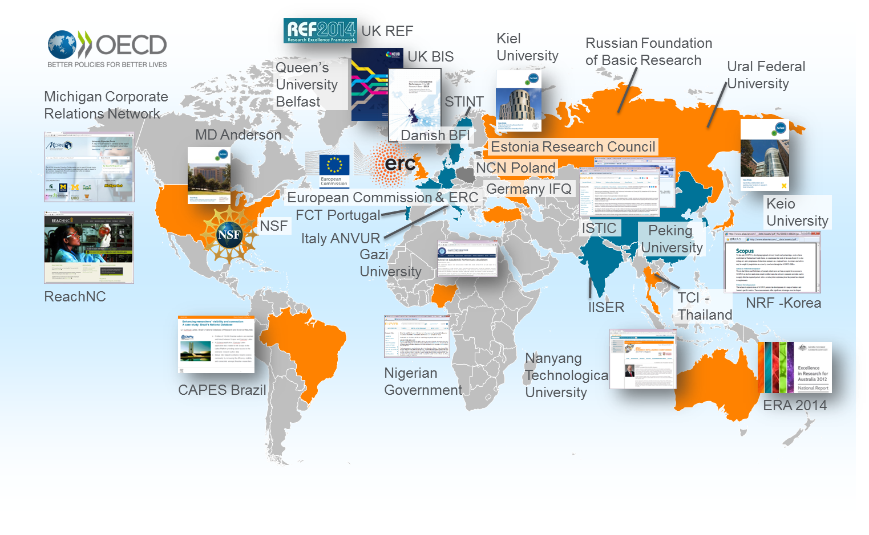

Who uses Scopus?
Scopus is recognized as the Gold standard in 4.500 universities and 150 leading research organizations worldwide. A lot of global key reports and national assessments also use Scopus data

Slide 11

WHAT ARE THE ABILITIES OF SCOPUS?
DOCUMENT SEARCH
01
02
AUTHOR SEARCH
Find the latest search
Discover subject areas through different filters such as language, document type, country, access type etc.
Benefit from document analysis tool
Find +13 million author profiles
Measure the impact of any researcher : Evaluate their documents, h-index
Find possible collaborations
Find experts in a specific subject
Benefit from author analysis tool
AFFILIATION SEARCH
03
04
FIND THE RIGHT JOURNAL
Find +70,000 affiliation profiles
Measure the impact of any affiliation : Evaluate their performance through its documents, authors, and collaborators
Find new opportunities as a researcher
Compare different journals according to subject area or publisher by different metrics

Slide 12
Why Analysis Tools are important?
Evaluate any subject area : See top author, top country, top affiliation in the world
Easily determine possible collaborators and partnerships
See the publication trend year by year, is this topic getting popular in the world?
See top funding institutions in that subject

Slide 13
What Scopus search does automatically?
Accented characters :
Lemmatization: attack, attacks ; wide, wider
Equivalents: behaviour and behaviour, ω and omega
Punctuation: is ignored – commas, hyphens, ? ! Etc
Stop words: words like ‘the’, ‘it’ and ‘of’ are excluded from search
- A list can be found in Scopus help
6. Override with exact phrase : { } will find only an exact match for a word, phrase or character (including stop words)

Slide 14
Phrases and separate words
For example: typing conversion disorder could find a document with disorders of vision in the title and image conversion in the keywords at the same time.
IF you do not specify anything between two words, Scopus joins them with AND so the words
may not necessarily be together
IF you want to search for exact phrases, you should use “double quotes’’
For example : typing “ conversion disorder” will find you the documents that include thisphrase
in exact order.

Slide 15
More Tips
Quotation Marks (“ ”)
Let’s say we are searching for heart attack:
Heart attack → the results will include all documents which have both words occurring them, even if they are far away from each other: the results will be same as for a search phrase of heart AND attack
“heart attack” → the results will include all docs which have words heart and attack next to each other in exactly the given order
“heart att*” → the results will include all docs which have a phrase starting with ‘heart’ followed by any word beginning with ‘att’ i. e. attack, attribute, attractive, attentive etc
Punctuation is ignored (heart-attack = heart attack)
Both singular and plural forms, as well as typical variations in spelling (color-colour) are included.

Slide 16
More Tips
Brackets { }
{Heart attack} → the results will include all documents in which the exact phase heart attack is present
{heart?} → replaces a single character, results will include heart, hearts, hearty etc.
{h*r*t} → replaces zero or more characters; heart, harvest, homograft, hypervalent etc
Punctuation is NOT ignored (heart-attack =/= heart attack)
Both singular and plural forms, as well as typical variations in spelling (color-colour) are included.

Slide 17
More Tips
Proximity
You can determine the proximity of the search terms:
W/n→ determines how many words can separate the two entered search terms, it does NOT determine which word is the first one.
Pain W/3 morphine → the results will include all entries where the words ‘pain’ and ‘morphine’ are no more than 3 words apart.
PRE / n → acts in the same manner as W/n BUT it determines the order of the worlds.
Pain PRE/3 morphine → the results will include all entries where the word ‘pain’ is followed by ‘morphine’ and is no more than 3 words away.

Slide 18





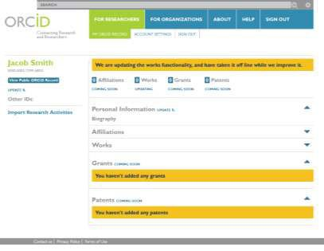
What is ORCID?
Many researchers have names that too closely resemble each other. In order to prevent name ambiguity, we strongly recommend researchers to have ORCID, since Scopus Author profile and ORCID complement each other.
Dr. Smith
Dr. J. Smith
Dr. James Smith
Dr. James Smith
46533489
ORCID Mission:
ORCID aims to solve the name ambiguity problem in research and scholarly communications by creating a central registry of unique identifiers for individual researchers

Slide 19
Content Selection in Scopus

Slide 20

Selection Process & Criteria
Scopus content is selected via independent Content Selection & Advisory Board (CSAB)
The CSAB is an independent board of subject experts from all over the world.
Board members are chosen for their expertise in specific subject areas; many have (journal) Editor experience.
The CSAB is selective and strict on quality: in total 5,411 titles reviewed (2011 –2015) of which 2,587 (48%) accepted for Scopus
For more info:
https://www.elsevier.com/solutions/scopus/content/content-policy-and-selection or titlesuggestion@scopus.com
https://www.elsevier.com/__data/assets/pdf_file/0006/95118/SC_FAQ-content-selection-process-22092014.pdf

Slide 21
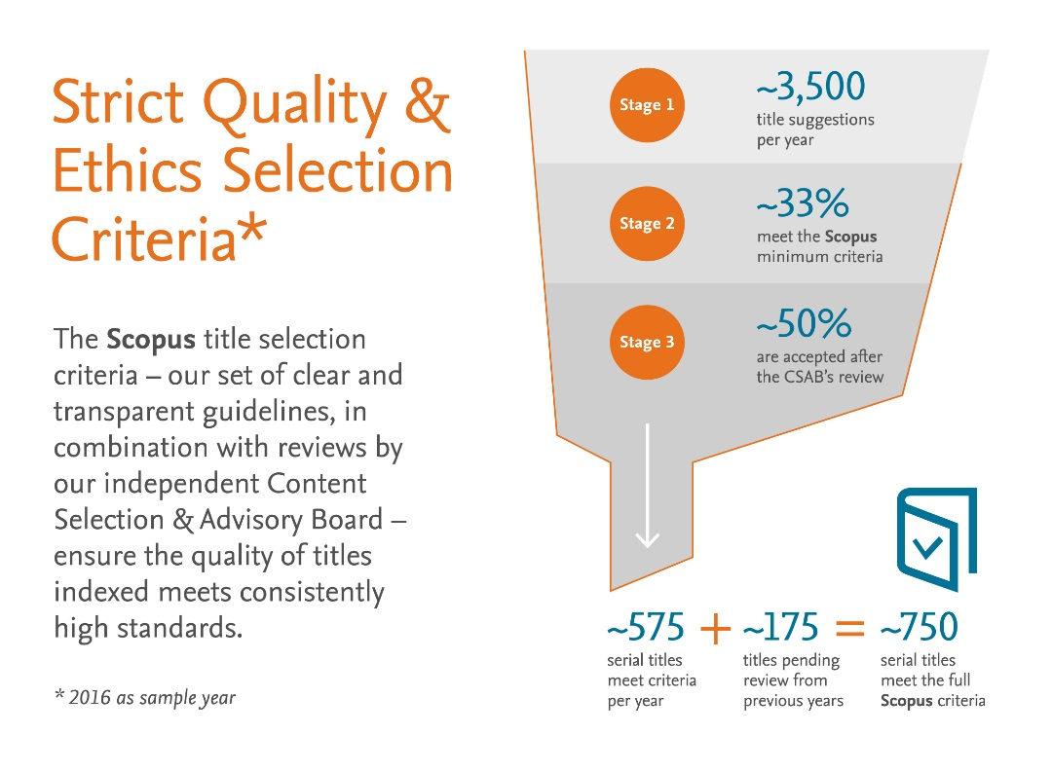
Maintaining high-quality: Scopus rigorous re-evaluation process and criteria

Slide 22
Selection Process & Criteria
All titles should meet all minimum criteria in order to be considered for Scopus review:
Peer-
reviewed
English abstracts
Regular publication
Roman script references
Pub. Ethics statement
Journal policy
Quality of Content
Journal standing
Regularity
Online Availability
• Convincing editorial concept/policy
• Type of peer-review
• Diversity geographic distribution of editors
• Diversity geographic distribution of authors
• Academic contribution to the field
• Clarity of abstracts
• Quality and conformity with stated aims & scope
• Readability of articles
Eligible titles are reviewed by the CSAB according to a combination of 14 quantitative and qualitative selection criteria:
• Citedness of journal articles in Scopus
• Editor standing
• No delay in publication schedule
• Content available online
• English-language journal home page
• Quality of home page

Slide 23


Structural approach: Ongoing content curation to ensure continuous high quality content
Curation of the full journal base is essential and expected by our customers and users.
There is transparent, annual re-evaluation process to ensure titles continue to meet high quality standards
Sudden output growth & shift in geographical diversity
Direct feedback from users and stakeholders on poor performing journals
Identification of poor performing journals using metrics and benchmarks
“Radar” to predict journals with outlier performance
Review:
Re-evaluation by the Content Selection & Advisory Board (CSAB)
Content Curation
Curate:

Slide 24
Research Metrics in Scopus

Slide 25
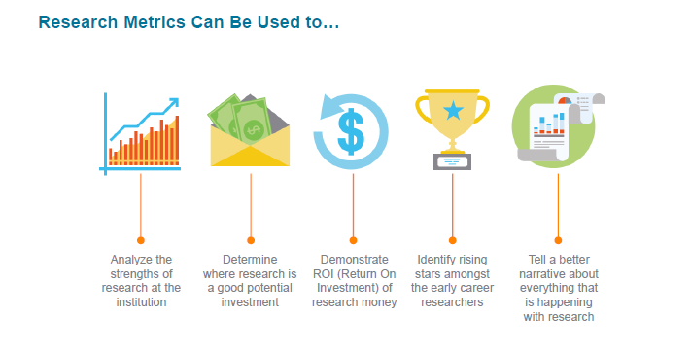
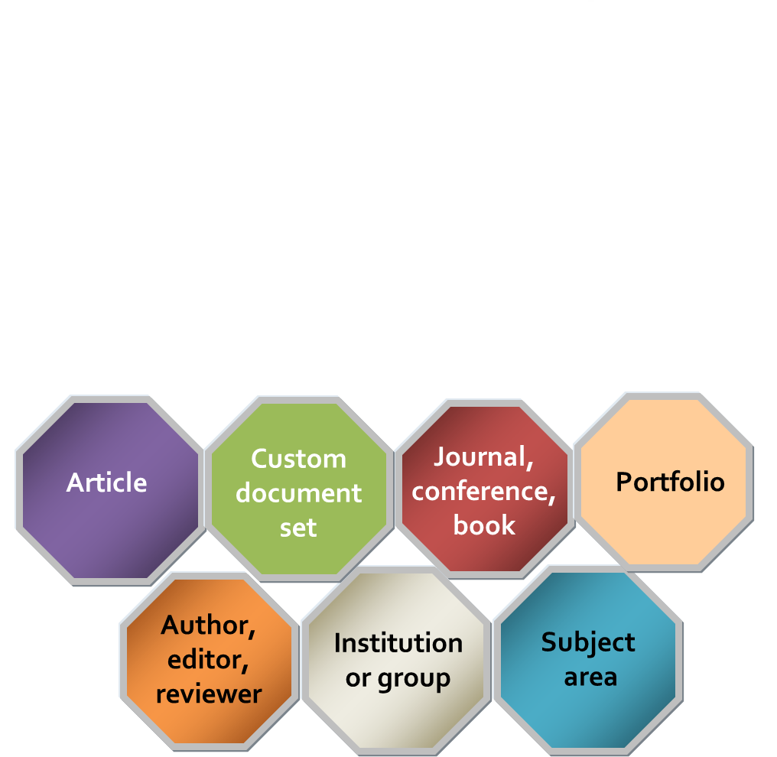
WHY USE RESEARCH METRICS?
Entities to which
metrics apply:
It is critical to use right metrics for right entities, and not missing them with each other!

Slide 26

GOLDEN RULE
When used correctly, research metrics together with qualitative input give a balanced, multi-dimensional view for decision-making
Golden rule #1
Golden rule #2
Always use both qualitative and quantitative input into your decisions
Always use more than one research metric as the quantitative input
“There is no single ‘best’ indicator that could accommodate all facets of the new reality of bibliometrics.”
- Wolfgang Glänzel, Head of bibliometrics group
Professor at KU Leuven, Belgium

Slide 27
METRICS IN SCOPUS
Variety of metrics are available in Scopus to better analyze and evaluate the research
Journal Level Metrics
Article Level Metrics
Author Level Metrics
CiteScore
SNIP
SJR
Citation Count
Field weighted citation impact (FWCI)
Plum metrics
Document Count
Citation Count
H-Index
Co-authors Count

Slide 28
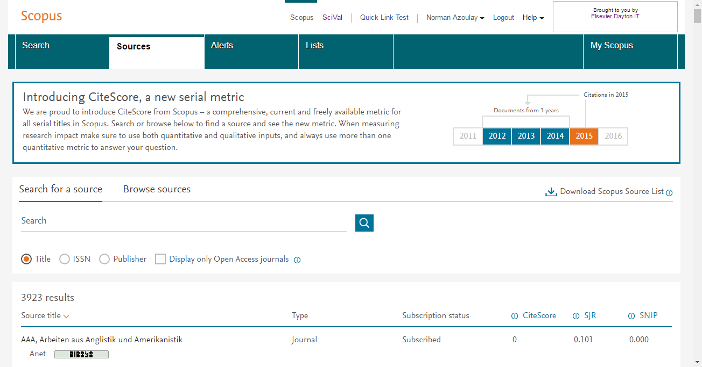
Journal Level Metrics in Scopus
CiteScore : CiteScore calculates the average number of citations received in a calendar year by all items published in that journal in the preceding 3 years. Calculation is below:
1
A
A
CiteScore 2015 value
=
B
Differences from Impact Factor:
IF - citation to 2 or 5 years of documents are covered.
Citations in all type of documents in these years covered, while citable items are only articles and reviews
B
Advantages of CiteScore:
Comprehensive: based on Scopus, available for all serial titles
Transparent: Available for free, easy to calculate for yourself. Underlying database is available for you to interrogate
Current: Updated monthly. New titles will have CiteScore a year after indexed
www.journalmetrics.com

Slide 29
Journal Level Metrics in Scopus
2
SNIP – Source Normalized Impact per paper :
It is developed by Henk Moed - CWTS (Centre for Science and Technology Studies)- Leiden University
It Measures the average citation impact of the publications of a journal, correcting for the differences in citation practices between scientific fields and therefore allowing for more accurate between-field comparisons of citation impact.
Its calculation is based on last 3 years.
It is field-normalized and allows us the direct comparison of sources in different subject fields!
SJR – SCImago Journal Rank:
3
It is developed by by Felix de Moya, CSIC (Spanish Research Council)
It is a Prestige metric -advocates not all citations are the same
Citations are weighted depending on the status of the source they come from.
The subject field, quality and reputation of the journal has a direct impact on the value of a citation. This means that a citation from a source with a relatively high SJR is worth more than a citation from a source with a lower SJR
Its calculation is based on last 3 years.
www.journalmetrics.com

Slide 30
Article Level Metrics in Scopus
1
Citation Count: indicates how many times a paper was cited (according to the data in Scopus)
2
FWCI – Field Weighted Citation Impact: indicates how well the paper is doing in comparison to others in the same field. The numerator contains the number of citations and the denominator contains the expected citation count, typical for an average paper in the field. Data is sourced from SciVal.
Average FWCI is 1, anything above 1 is considered as above average.
3
Mendeley: shows how many Mendeley users have this article in their libraries. It is an indicator of readability of the article.

Slide 31
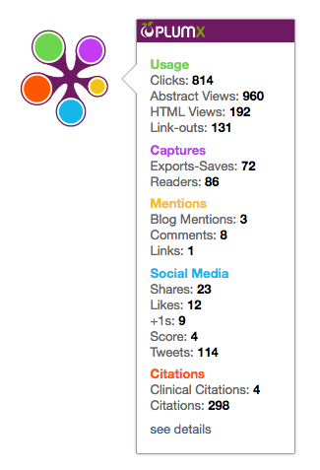






What is Plum Metrics?
Plum Metrics helps measure the impact of the documents by tracking online platforms
It includes 5 categories of metrics:
USAGE
(clicks, downloads, views, library holdings, video plays)
CAPTURES
(bookmarks, code forks, favorites, readers, watchers)
MENTIONS
(blog posts, comments, reviews, Wikipedia links)
SOCIAL MEDIA
(+1s, likes, shares, tweets)
CITATIONS
(citation indexes, patent citations, clinical citations)
Plum tracks activity from >50 platforms, and we continue to invest more:

Slide 32
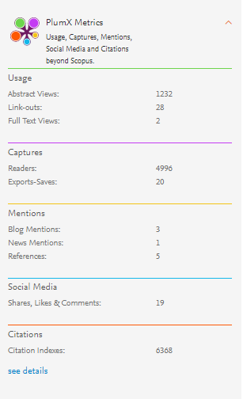
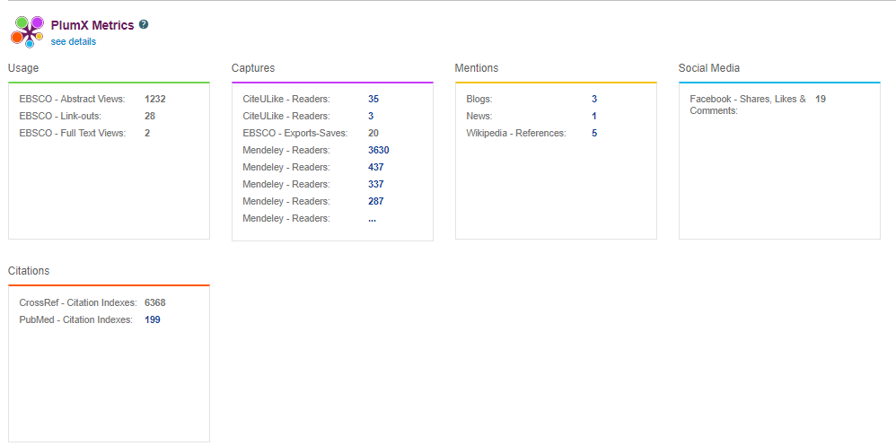
How to utilize Plum Metrics?
See the alternative metrics of the selected article such as usage, captures, mentions, social media and citations –these are shown only if available!
Once you click ‘see details’ link, it will show you all underlying data
This will help you showcase your research and measure its impact globally!

Slide 33
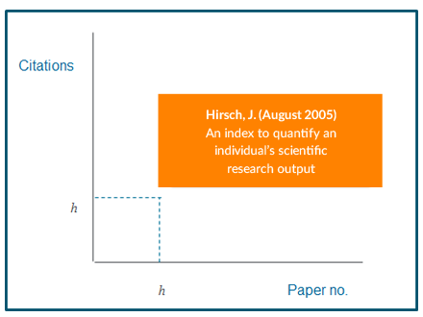
What is H-Index?
H- index :
It is Originated by Jorge Hirsch in 2005
A group of papers has index h if h of the papers have at least h citations each, and the other papers have no more than h citations each.
Attempts to measure both the productivity and impact of the published work of a scholar
Incorporates quantity and quality
Productivity and age constraints
If an author’s h-index is 10, it means he has 10 articles that each of them have at least 10 citations !

Slide 34
LIVE DEMO

Slide 35
SCIENCEDIRECT

Slide 36
WHAT IS SCIENCEDIRECT?
Elsevier’s leading information solution for researchers, a full-text platform for scientific, technical and medical journals & books.
420.000 peer-reviewed research articles published annually, including the Lancet and the Cell, and many iconic reference works, including Grey’s Anatomy.
14 million people per month use Science Direct, our flagship online platform for academic research
29 articles a second
Over 900 million full text articles were downloaded in 2016 alone.
#1 Global Provider
Publish 25% of world’s journal articles
2,500 active journals
35,000 book titles
900 serials
Over 14 million full-text content pieces with an average of citation share of 25.3%
Multi-disciplinary Content
A repository of full-texts from peer-reviewed sources cover 4 main areas, with 24 sub-titles:
Engineering
Life Sciences
Health
Social Sciences
ELS 25%

Slide 37
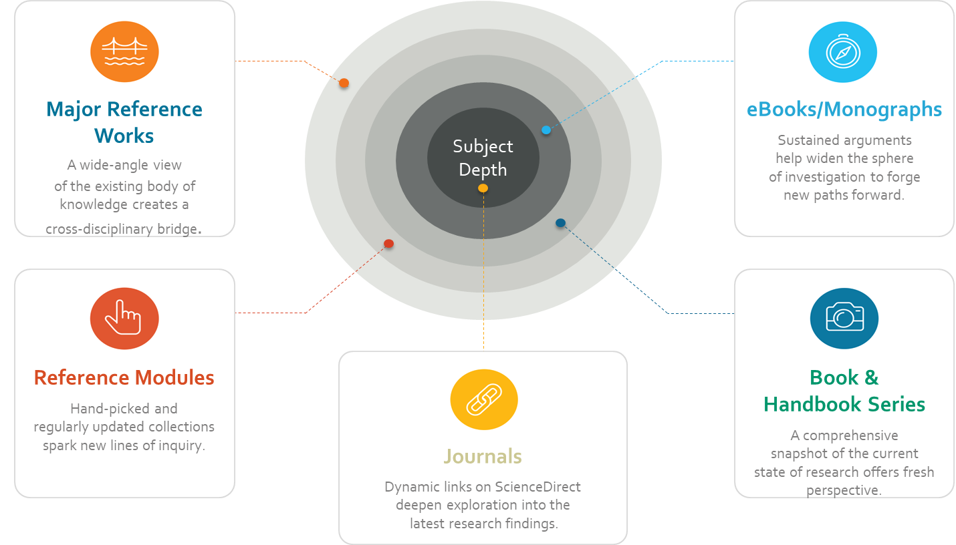
SCIENCEDIRECT CONTENT
Take advantage of mix content that is essential to contemporary researcher workflows

Slide 38
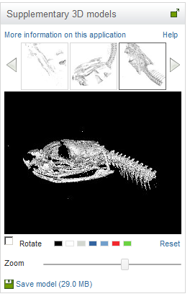
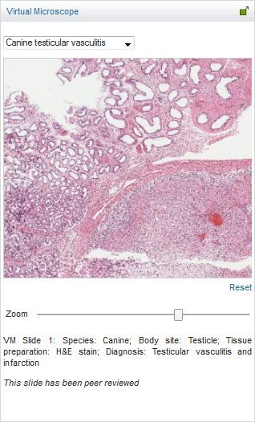
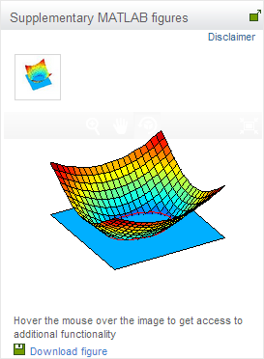
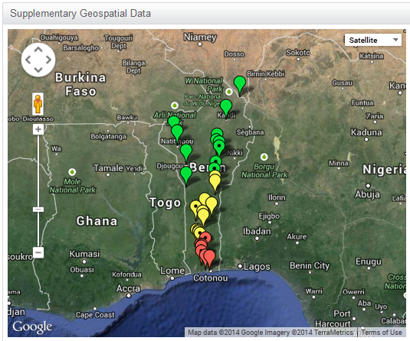
HOW SCIENCEDIRECT SUPPORT RESEARCH THROUGH TECHNOLOGY?
3D images, supplementary views, audio slides, interactive plots, virtual microscope views are available in ScienceDirect
Interactive plots...
3D models...
Google Maps...
Virtual Microscope...

Slide 39
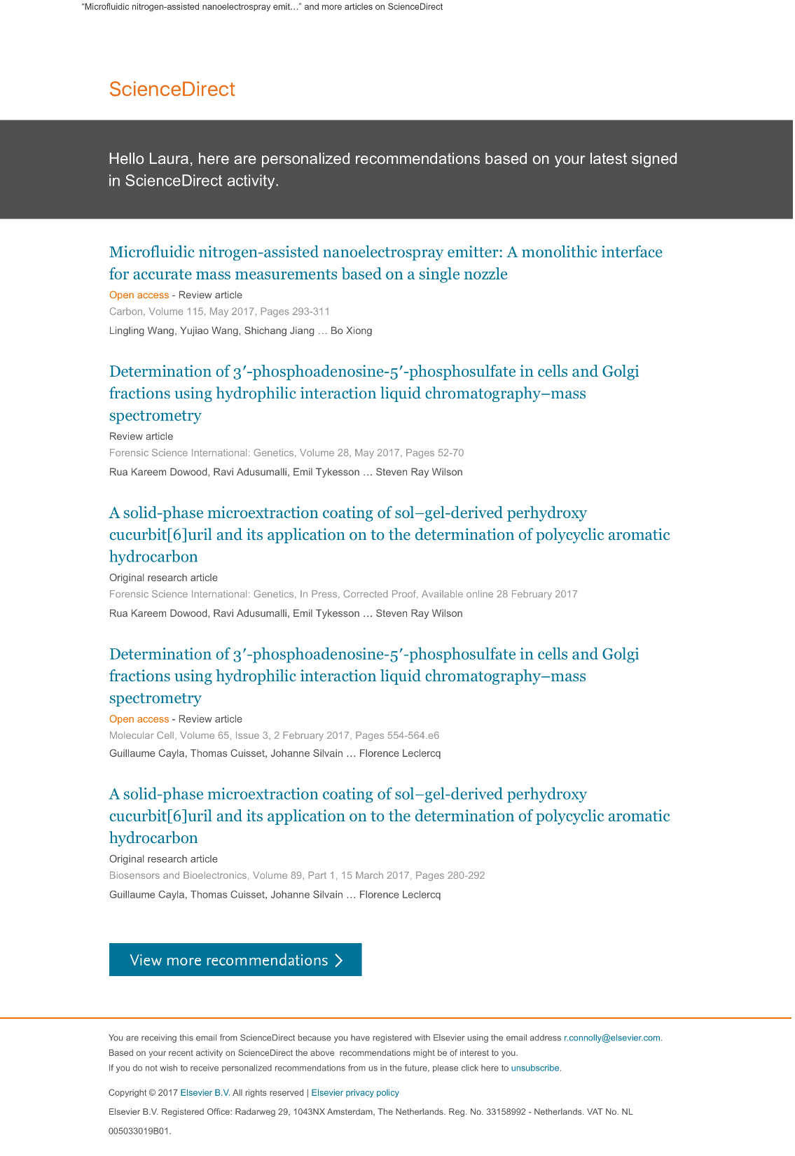

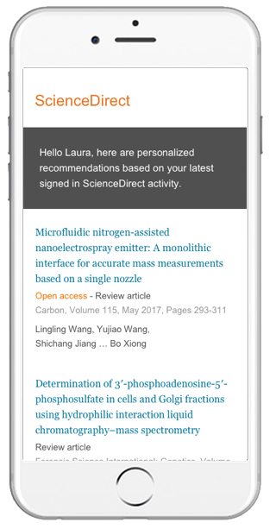
HOW SCIENCEDIRECT SUPPORT RESEARCH THROUGH TECHNOLOGY?
PERSONALIZED RECOMMENDATIONS
Based on last Sign-in activity, ScienceDirect offers you content personalized for you!!
Recommendations are delivered to your Inbox, and accessible anywhere you go!
More than 1 million researchers are already using our Recommendations service. Find out why…
“Provided me with articles I had previously not found… gave me new ideas for other application areas of the techniques I’m using...”
“This morning’s recommendation was relevant to my lecture last week, so we were able to start class by reviewing and adding a new perspective.”
Merlijn Lobbes | Graduate student
Sarah Longwell | Faculty

Slide 40

HOW SCIENCEDIRECT SUPPORT RESEARCH THROUGH TECHNOLOGY?
SCIENCEDIRECT TOPICS
Uncover critical and contextual information within your workflow via ScienceDirect Topics → easy tool to learn definitions of new terminology
Once you come up with unknown terminology in the text, click the world and check its definition!
1
Short definition*
2
Related terms
3
Excerpts from relevant Book content

Slide 41
LIVE DEMO

Slide 42

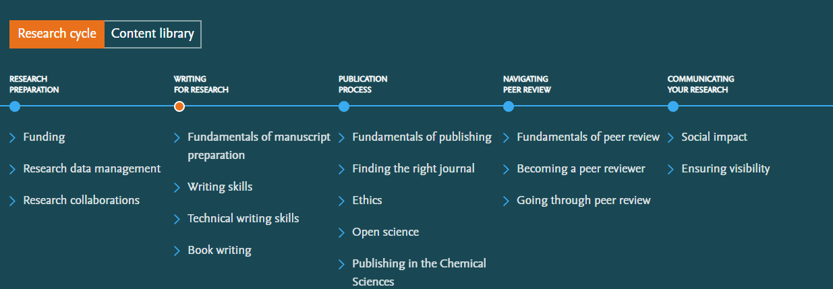
How to reach the resources by yourselves?
Researcher Academy provides free access to countless e-learning resources designed to support researchers on every step of their research journey.
Browse our extensive module catalogue to uncover a world of knowledge, and earn certificates and rewards as you progress.
https://researcheracademy.elsevier.com

Slide 43
How to reach the resources by yourselves?
https://researcheracademy.elsevier.com
Watch Scopus tutorials on various topics:
https://service.elsevier.com/app/answers/detail/a_id/14799/supporthub/scopus/
Subscribe Scopus blog to receive the latest developments and updates: www.Blog.scopus.com
Watch tutorials on various topics:
https://service.elsevier.com/app/answers/detail/a_id/10263/c/10544/supporthub/sciencedirect/kw/tutorial/
Check our website to get more detailed information about ScienceDirect
https://www.elsevier.com/solutions/sciencedirect
ScienceDirect support Center:
https://service.elsevier.com/app/home/supporthub/sciencedirect/
Follow us on Social Media: https://www.facebook.com/ElsevierGulfandLevant/ and

