Slide 1

Faculty Training Courses
How to use Trello in Project Management
Prof. Omar R. Daoud
Business 2-Lab 102 14th Sept. 2020

Slide 2

How to use
And organize your ideas..

Slide 3

Hi There! I’m Taco!
I’m Trello’s spokes husky

Slide 4

What is Trello?

Slide 5

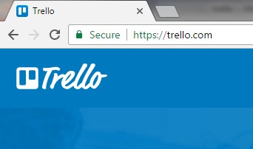
Trello is a free online app for organizing ideas and processes and more..

Slide 6

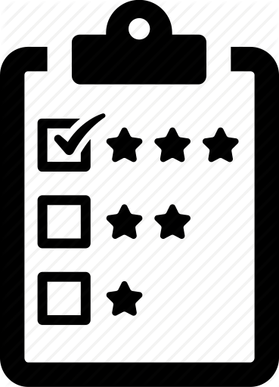
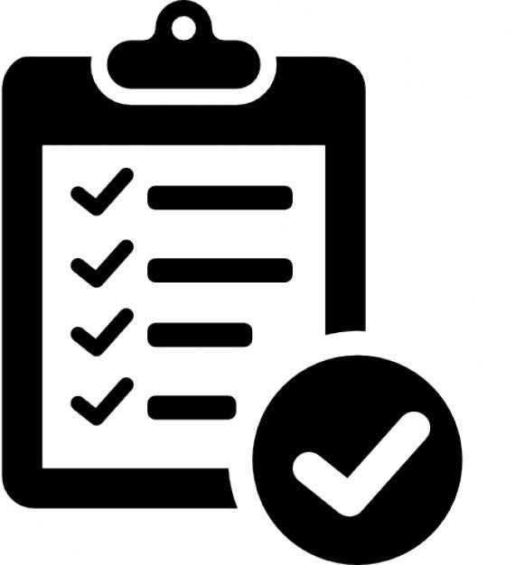
It has everything you need to organize projects of any size.

Slide 7

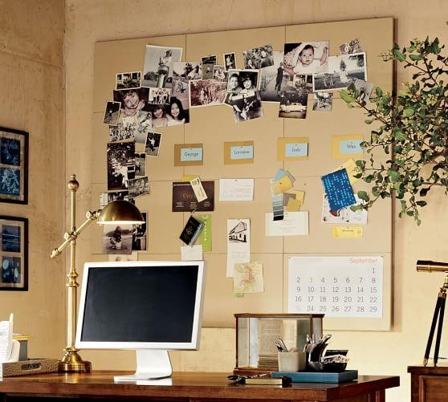
It works like a pin board

Slide 8


It can also be used solo, or you can invite colleagues, friends, and family to work together.

Slide 9
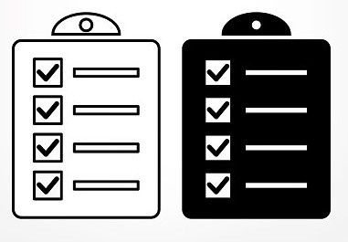
You can create checklist so you can keep track of to-dos, share updates and a lot more.

Slide 10
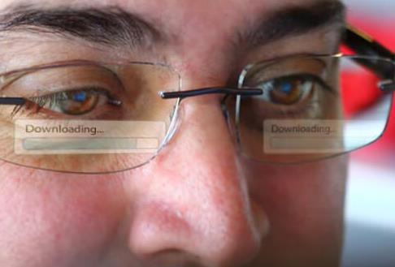
2 Things to remember with TRELLO
#1 TRELLO is very visual

Slide 11


It can be used to manage a project

Slide 12

2 Things to remember with TRELLO
#2 TRELLO is versatile

Slide 13




You can use TRELLO in many ways like

Slide 14


Personal and Team Projects

Slide 15


Collecting and organizing Ideas

Slide 16

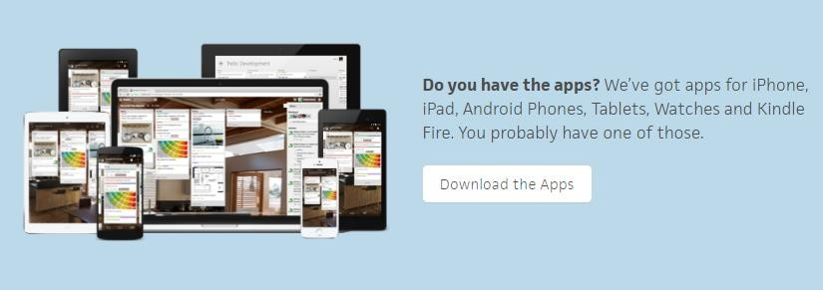
And Trello works in different platforms

Slide 17

Ready to make an account?

Slide 18

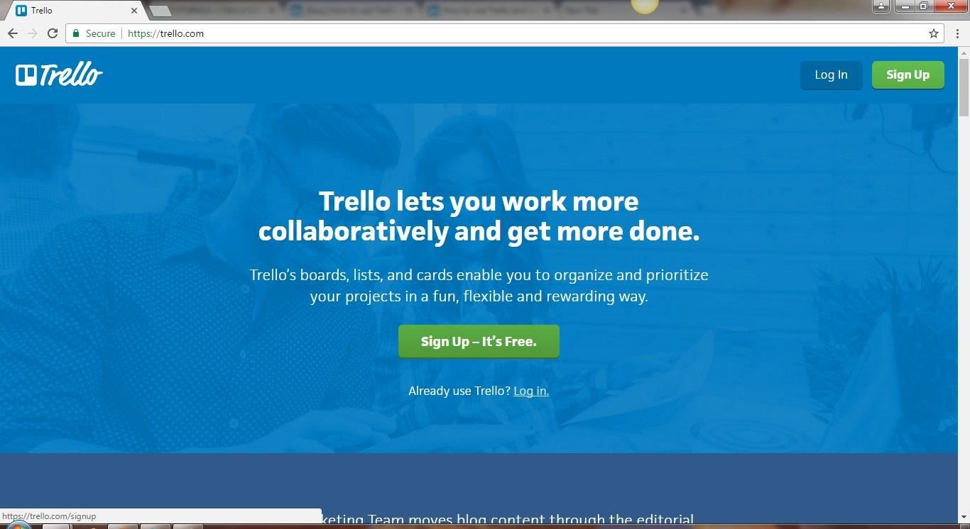
Go to trello.com

Slide 19

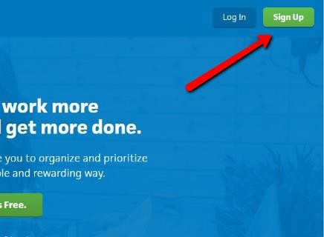
Click Sign Up

Slide 20

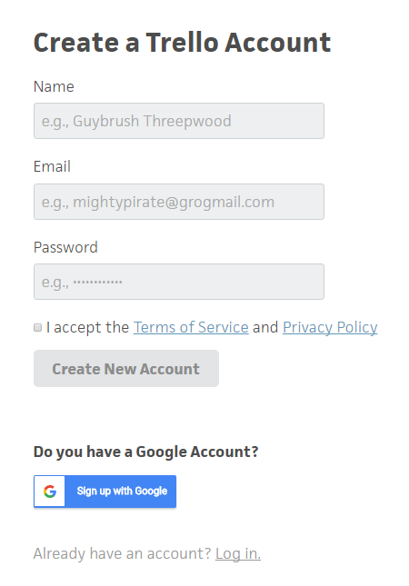
Fill up all the needed info

Slide 21

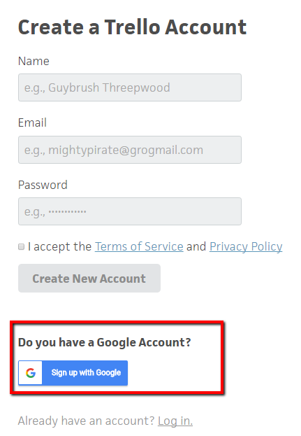
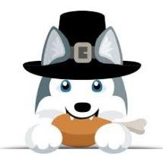
Or sign up with your google account

Slide 22


For this tutorial, we use our google account

Slide 23

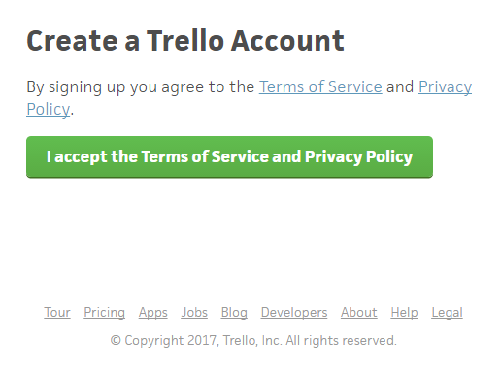
Click on the “I accept..” button to agree on the terms and condition

Slide 24

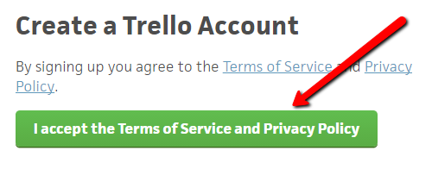

Slide 25

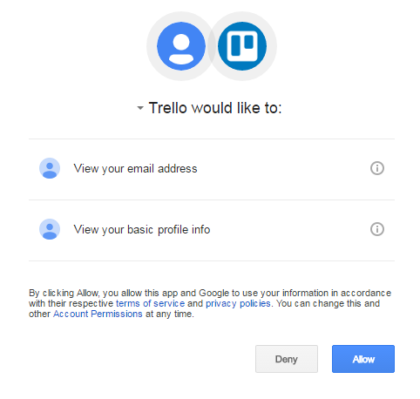

Trello will ask permission for your basic profile info

Slide 26

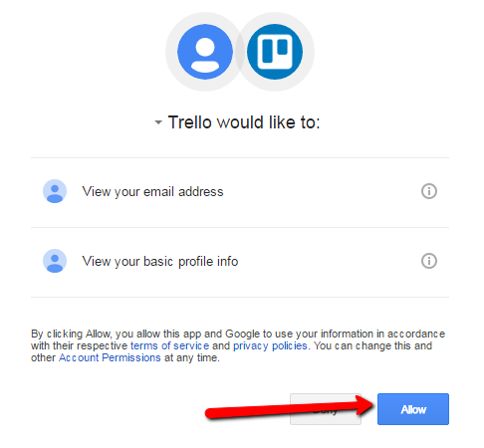
Click ALLOW

Slide 27


An email confirmation will be sent to you

Slide 28

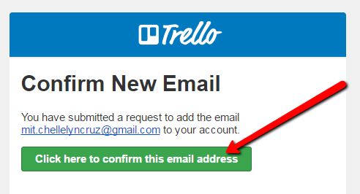
Open the email and click to confirm

Slide 29

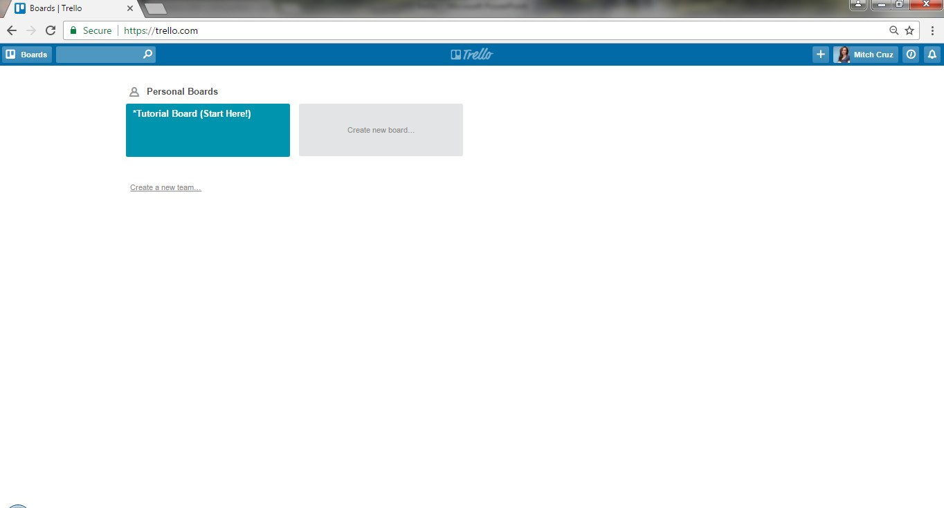

Welcome to your Trello Account

Slide 30
Sign Up Is Completed!

Slide 31

Let’s see how Trello works

Slide 32
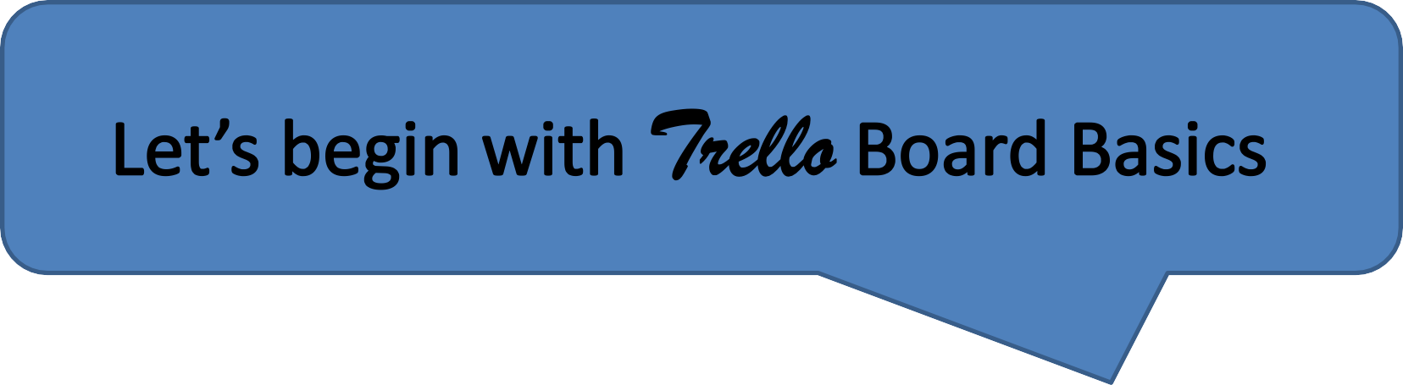

Slide 33

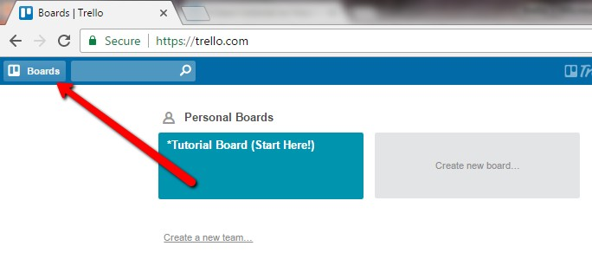
Let us create a Board

Slide 34
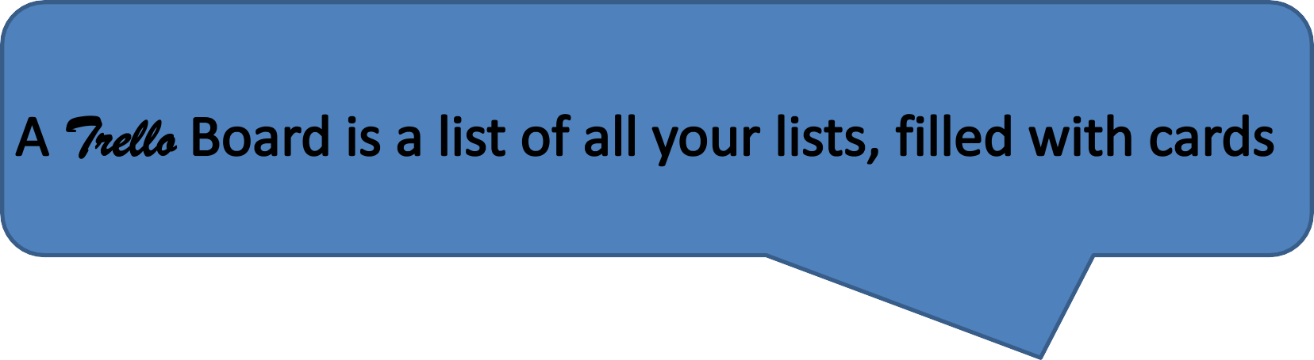

Slide 35

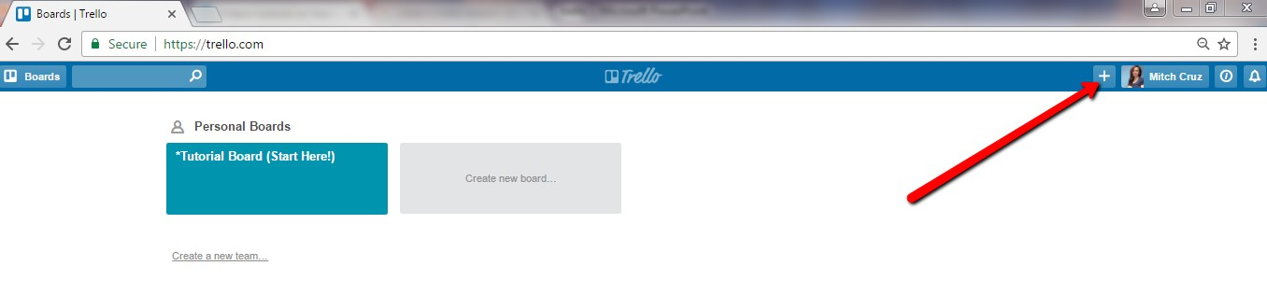
Click the + button to create

Slide 36

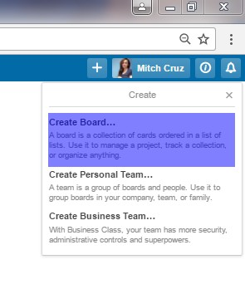
Click Create Board

Slide 37

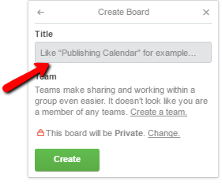
Write a title for the board

Slide 38

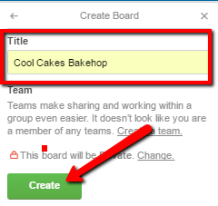
Then click “Create”

Slide 39

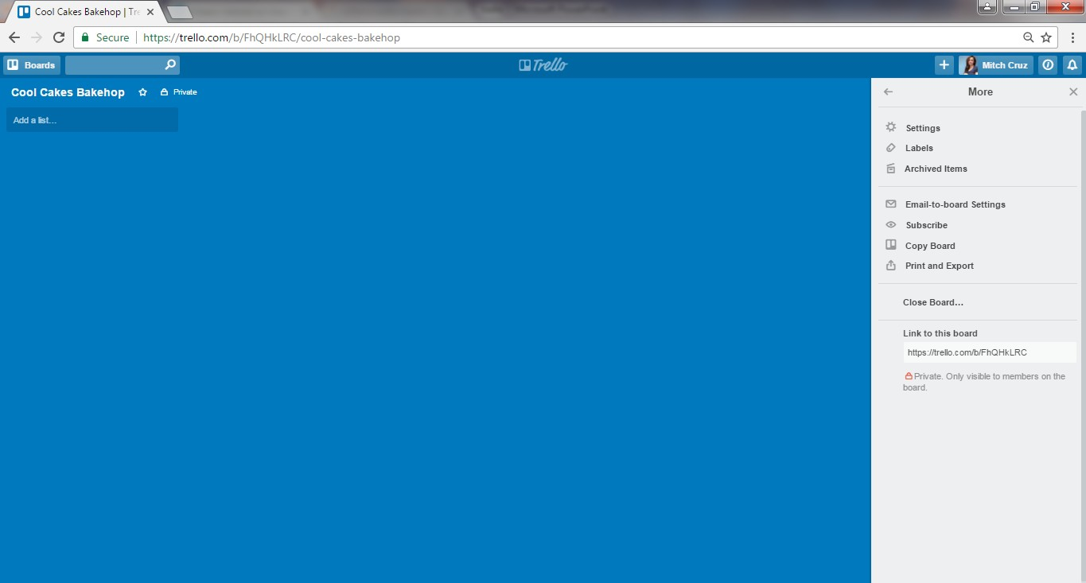
Great! You now have a board where your can use to create a list of your to-dos

Slide 40

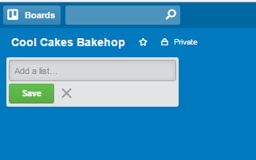
Click “Add a list”

Slide 41
We can now write the lists of things to be done in the Cool Cakes Bakeshop Board!

Slide 42

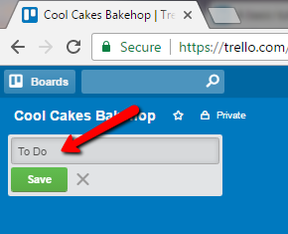
Type in “To Do”

Slide 43

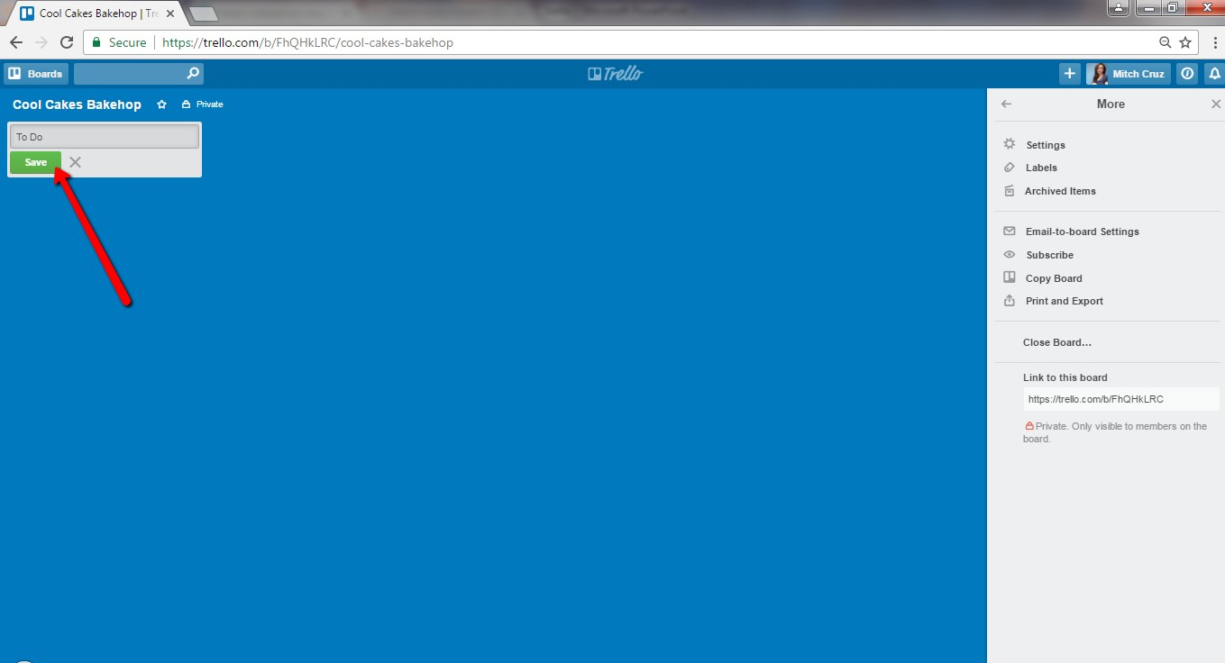
Then click “SAVE”

Slide 44

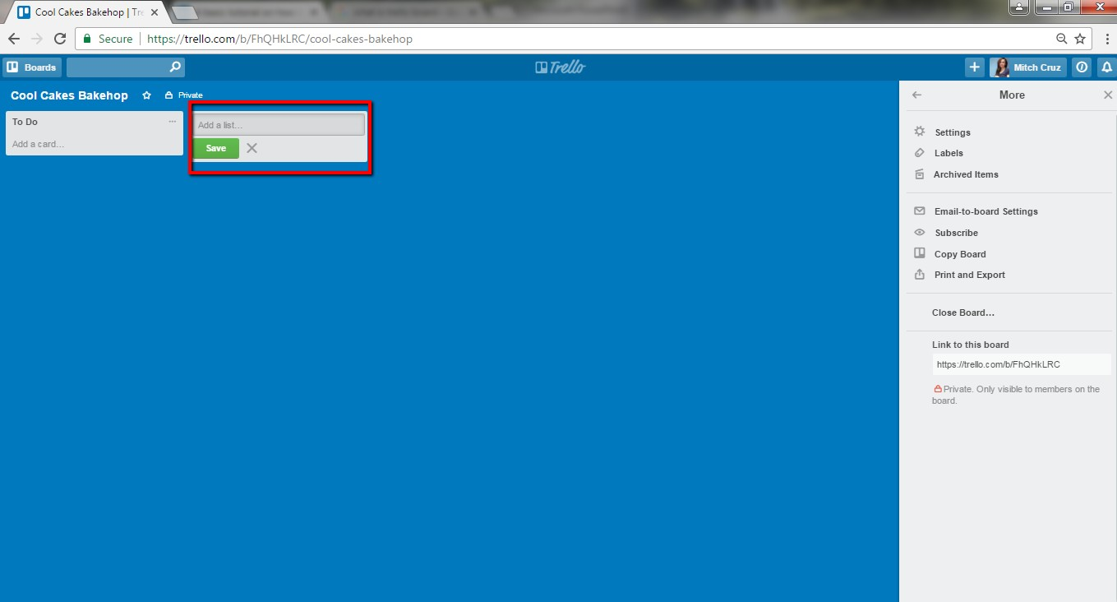
Yes! Go ahead! Add another list.

Slide 45

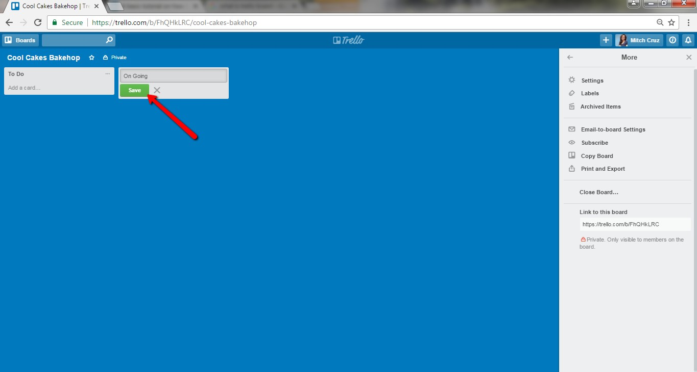
Then click “Save”

Slide 46

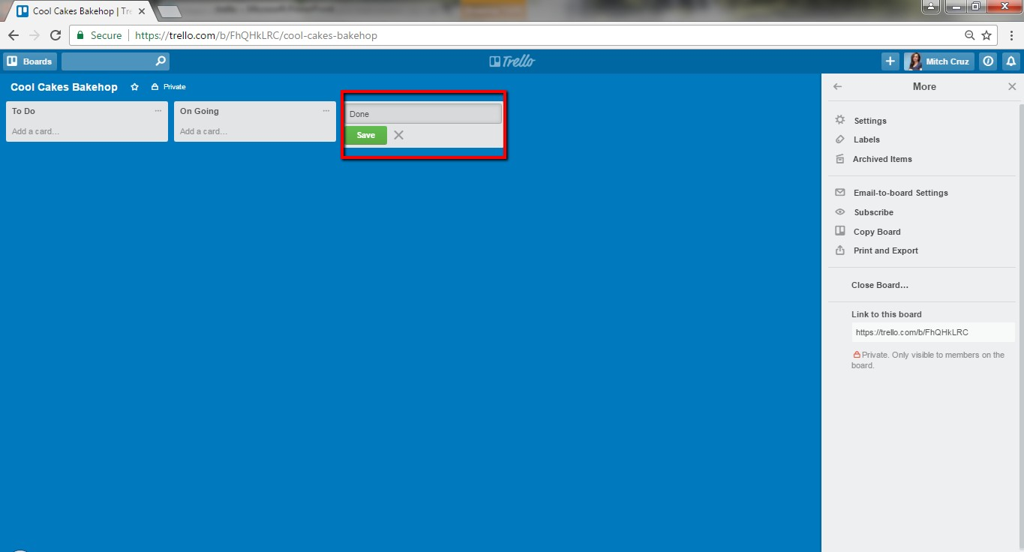
Add another list, write “Done”

Slide 47

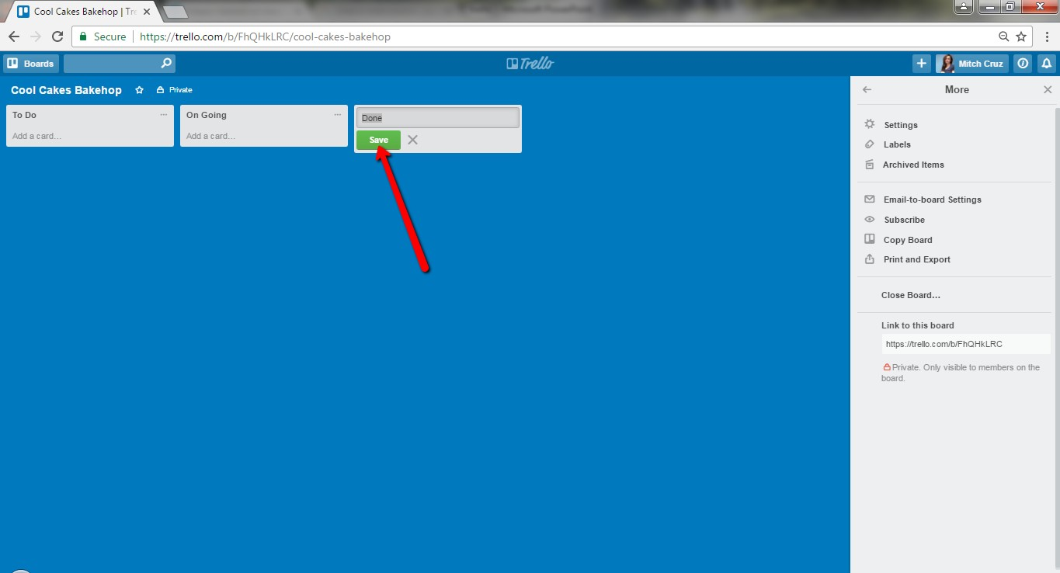
Click “Save”

Slide 48

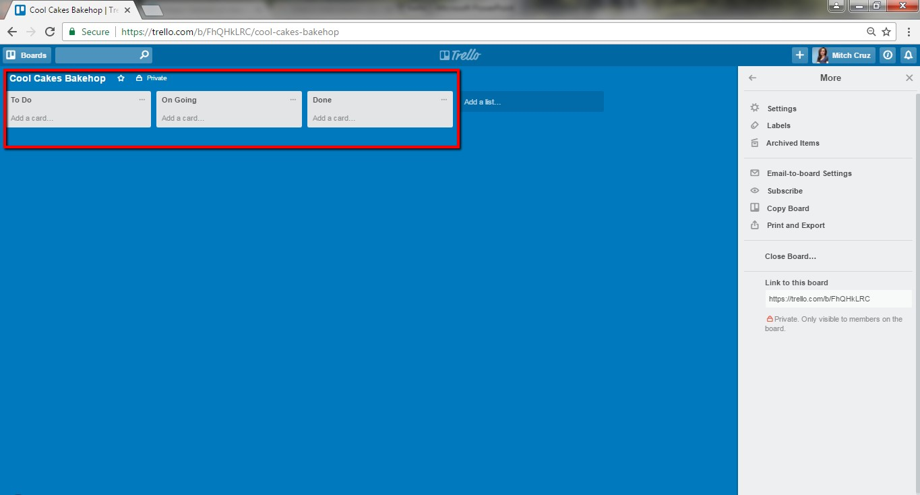
We now have 3 “to do” lists

Slide 49
We are now ready to add “cards” in our lists

Slide 50

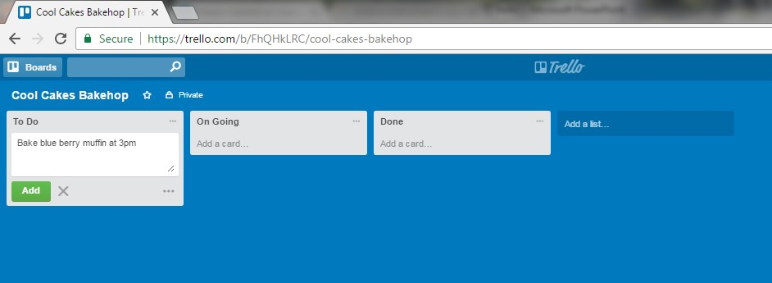
Click “add a card” then write you To-dos

Slide 51
Click “Add”

Slide 52

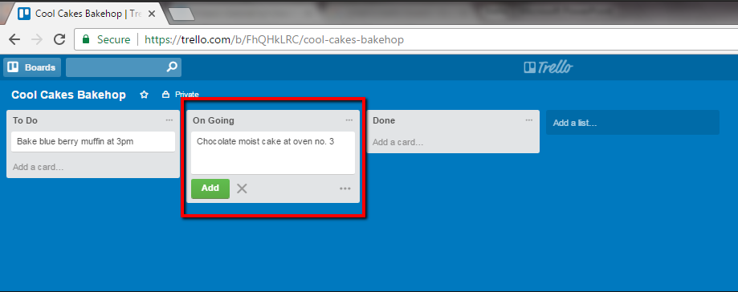
Click “Add a card” on the “On going” list

Slide 53


Then click “Add”

Slide 54

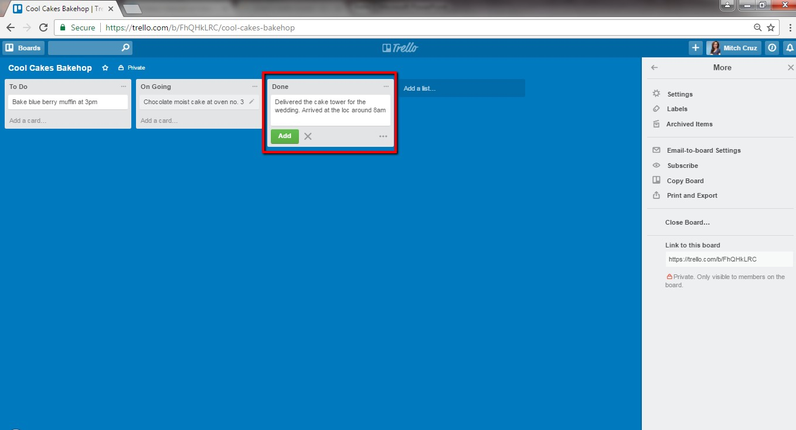
Now write the things that you are done with

Slide 55

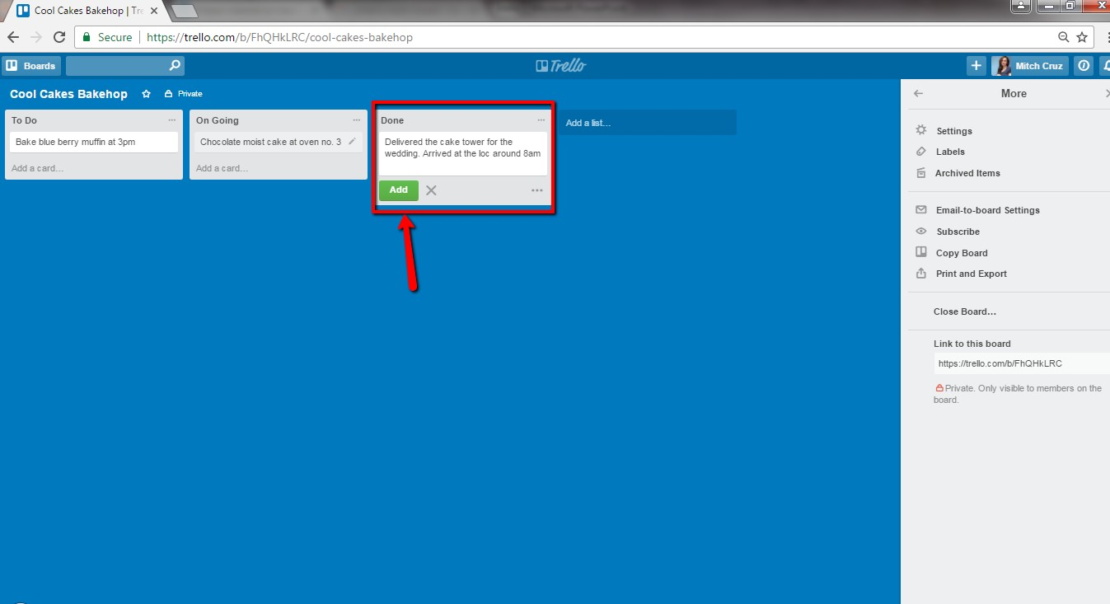
Lastly, click Add button

Slide 56

Awesome!

Slide 57

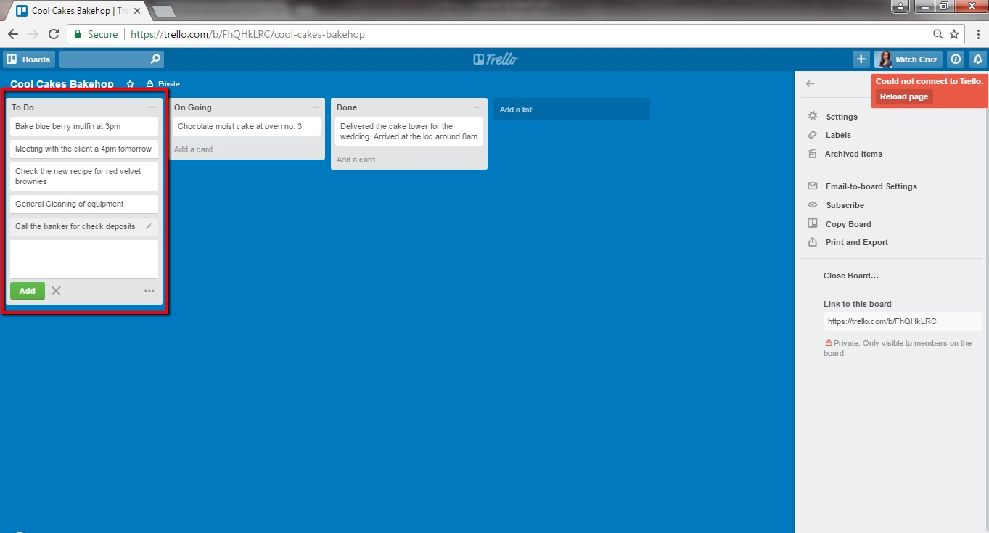
A “list” can contain many “cards”

Slide 58

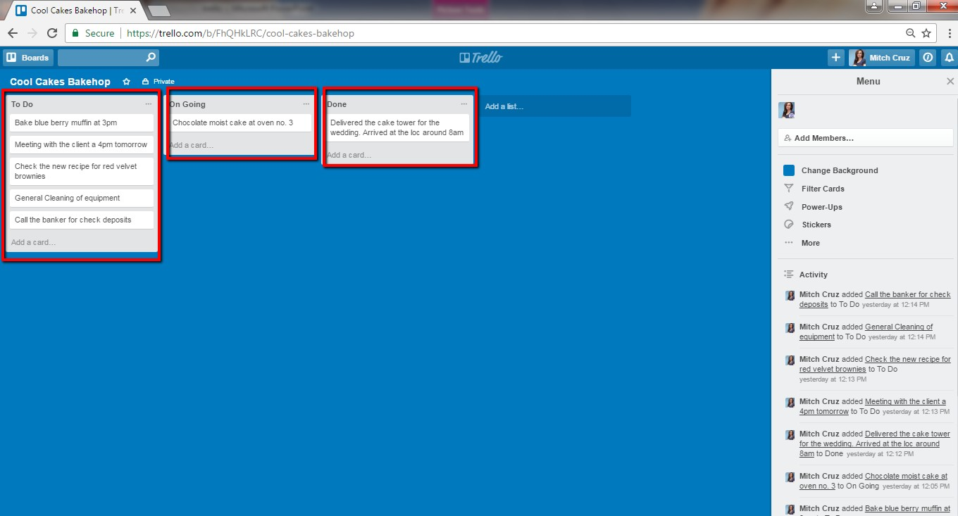
Trello Board is a list of list

Slide 59

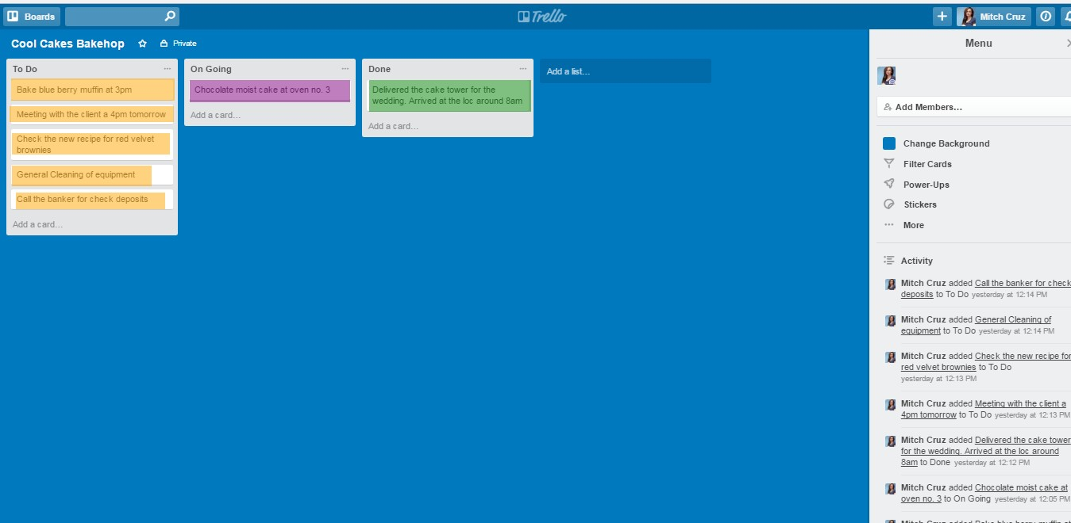
Filled with cards

Slide 60

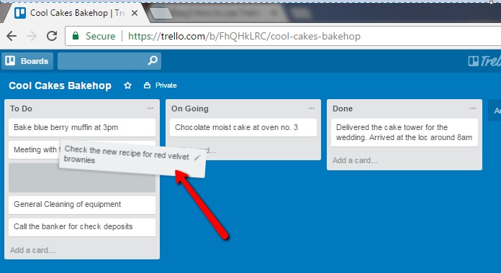
You can move the cards when you are currently doing it or once you are done, depending on the list

Slide 61

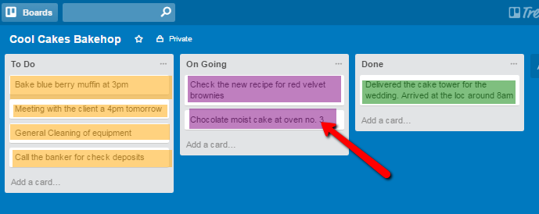

Slide 62
You can also put labels in your cards

Slide 63

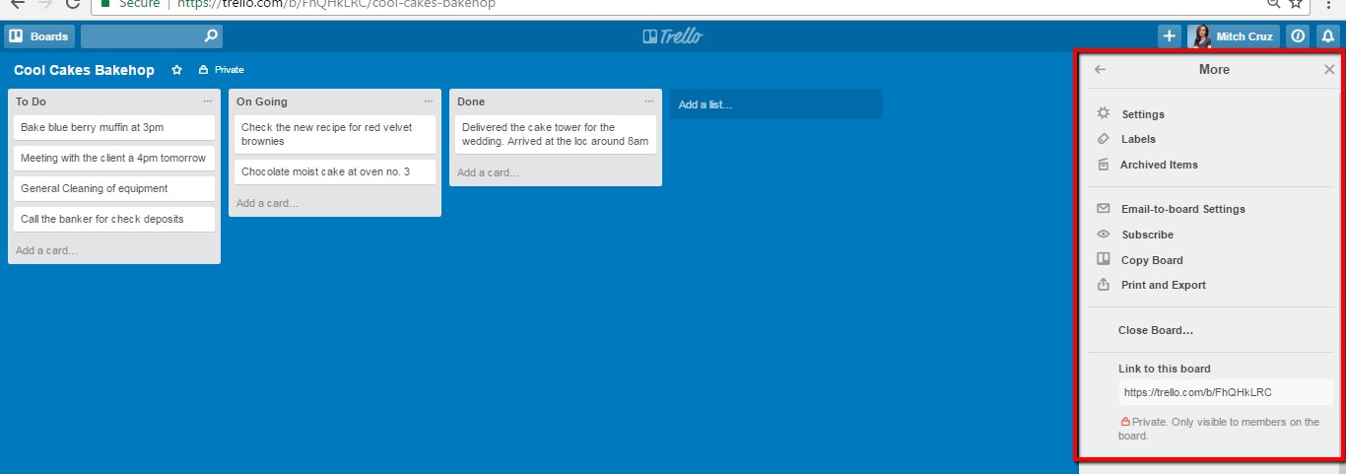
Labels are located at the right side of the page

Slide 64

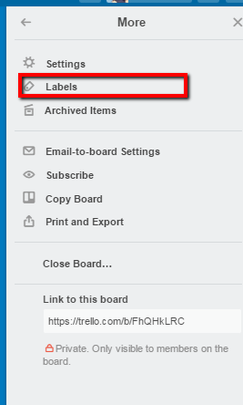

Slide 65

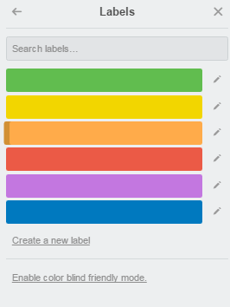
Trello labels are represented by colors

Slide 66


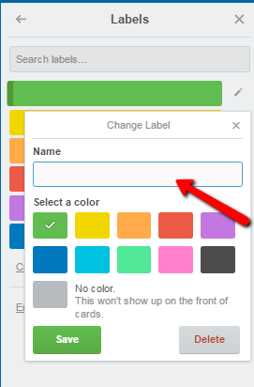
You can also add name on the label

Slide 67

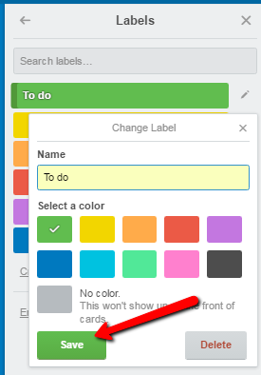
Go ahead and click SAVE

Slide 68

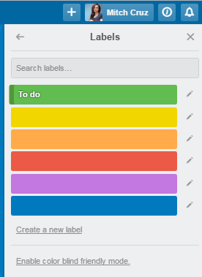
Lets add more labels

Slide 69

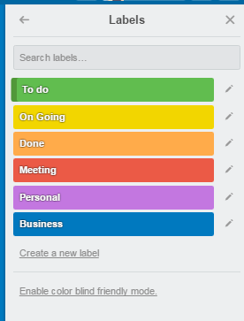
Great!
We now have labels for our lists

Slide 70


We can also add labels by clicking the card

Slide 71


Click Labels

Slide 72



Slide 73


Or click the edit button

Slide 74



Slide 75



Slide 76


Choose a label

Slide 77


Then click SAVE

Slide 78


This card has a green label

Slide 79


All the cards on this list has a green label

Slide 80
Let’s do the same with the rest of the cards

Slide 81



Slide 82



Slide 83
Great! We now have labels on our cards!

Slide 84

Let’s keep going!

Slide 85
By default, boards are set to private

Slide 86



Slide 87
But you can always set boards to public or team visible

Slide 88


You can change it by clicking “Private” button

Slide 89
You can change it by clicking “Private” button

Slide 90
For now, let us just keep it private

Slide 91
You can also create your own team using Trello

Slide 92
What is a Team?

Slide 93
A team is a group of boards and people. It helps keep your company, team, or family organized.

Slide 94
Here’s how..

Slide 95


On your Personal Boards, click “Create a new team”

Slide 96



Slide 97


Fill up the boxes with the needed info then click “Create”

Slide 98


You will see this page after clicking create button

Slide 99
This functions like your personal board but is visible only to the members of the group

Slide 100

That’s it! We now know how to use Trello and it’s functions!

Slide 101

Thanks! I’m done for the day!

Slide 102


And remember.. choose to be happy, always.

