Slide 1

Faculty Training Courses
Best Practices to Get Funding: Networking & How to Prepare a Project File for Submission
Prof. Omar R. Daoud
Prof. Munzer Ubeid
Faculty of Nursing Auditorium 22nd Sept. 2020

Slide 2
Why Funding?
Enables research
Attracts Ph.D. students
Can build collaborations, increase exposure
Measure of quality
Helps school -- overhead and student support, which provides growth
Can help in promotion
Can add to income through summer salary, or can relieve teaching
http://research.usc.edu/files/2011/05/funding_strategy_workshop.ppt

Slide 3
Funding Cautions
Develop coherent research program
Do not distract from publications or other creative endeavors
Continuity of support
Effort should not be overwhelming
Better to pass an opportunity, than to embark on one with little chance of success
Be prepared for rejection
http://research.usc.edu/files/2011/05/funding_strategy_workshop.ppt

Slide 4
Creating the Strategy
Set your own vision: what do you want to be known for 5 years from now
Assess your own capabilities and passions for research
Identify capabilities that you can leverage here -- do not become isolated
Create milestones needed for tenure
http://research.usc.edu/files/2011/05/funding_strategy_workshop.ppt

Slide 5
More Strategy
Assess the Market
Identify agencies and programs that fund related research
Determine how your vision can be crafted to match funding priorities
Create a proposal writing schedule
http://research.usc.edu/files/2011/05/funding_strategy_workshop.ppt

Slide 6
Next Steps in Securing Funding
1. Identify relevant funding agencies
2. Research the programs
3. Get to know the program officer
4. Write a responsive proposal
5. Get feedback and revise
http://research.usc.edu/files/2011/05/funding_strategy_workshop.ppt

Slide 7
1. Identify relevant agencies
Goal: find the sources of funding
Contact your peers, mentors, either at PU and elsewhere
Find out where other universities get funding in your area
Attend relevant conferences
Search the web
http://research.usc.edu/files/2011/05/funding_strategy_workshop.ppt

Slide 8
2. Research the programs
Goal: determine priorities and selection process
Read material on the web
Program priorities, who has been funded and for what, review process; who decides and how peer review is conducted; total dollars; size and duration of awards; success rate
Contact program officer
What is the real story on funding; obtain suggestions on how to structure proposal; volunteer to be on review panel
Contact other people who have been funded
What did it take for them to get funded; get example of a funded proposal
http://research.usc.edu/files/2011/05/funding_strategy_workshop.ppt

Slide 9
3. Get to Know the Program Officer
Goal: Make your research a priority within the program
Visit and meet in person; present your ideas and get feedback; find out what the program officer cares most about; find out & influence what will happen in future
Volunteer to serve on a review panel
Try to connect to program officer through conferences, professional meetings
Treat him or her like a customer
http://research.usc.edu/files/2011/05/funding_strategy_workshop.ppt

Slide 10
4. Write a Responsive Proposal
Goal: Be responsive, innovative and communicate well
Parse the Request for proposal(RFP); make sure that you have addressed all requirements
Write the proposal for the audience (understand who are the reviewers)
Create an appropriate budget and plan
Excel in all categories
http://research.usc.edu/files/2011/05/funding_strategy_workshop.ppt

Slide 11
4a. Develop Concept
Understand literature and needs
Build from your strengths
Identify/develop partners
Reaction from colleagues and peers
http://research.usc.edu/files/2011/05/funding_strategy_workshop.ppt

Slide 12
4b. Writing
Follow section format exactly
Clear statement of benefits and significance: in abstract, introduction, conclusions
Complete review of relevant literature
Include clear schedule, and describe the deliverables
Justify budget expenditures
Present your qualification
http://research.usc.edu/files/2011/05/funding_strategy_workshop.ppt

Slide 13
5. Get Feedback and Revise
Goal: Make sure you got it right
Complete proposal at least 3 weeks before deadline
Show proposal to a peer who knows your area of work well
Show proposal to a peer who is not a specialist in your area
Show proposal to a non-researcher
http://research.usc.edu/files/2011/05/funding_strategy_workshop.ppt

Slide 14
Proposal Writing
A good research proposal demonstrates innovation and significance within its field of study
http://research.usc.edu/files/2011/05/funding_strategy_workshop.ppt

Slide 15
Myths of Proposal Writing
Technical and scientific merits alone determine winners
Proposals should always be written for the top experts in your field
Only peers pick proposals
Don’t ask your colleagues to review your proposal
http://research.usc.edu/files/2011/05/funding_strategy_workshop.ppt

Slide 16
More Myths
It’s a good idea to submit the same proposal to several agencies
Follow your own writing style -- reviewers don’t care about the guidelines
Don’t worry about schedules and deliverables -- this is research
http://research.usc.edu/files/2011/05/funding_strategy_workshop.ppt

Slide 17
Reality
Reviewers often do not read proposals carefully, and they frequently look for the “big idea”
Reviewers also look for reasons to deny proposals -- there should be no holes
Reviewers are not always experts
Managers make the final decision, and influence the process
http://research.usc.edu/files/2011/05/funding_strategy_workshop.ppt

Slide 18
Grant Proposal Planning & Development
The 10 most common grant seeking mistakes
The writing in the proposal isn't succinct or intelligible, resulting in a proposal that doesn't make sense.
The costs for technology items are inaccurate or, in the worst case scenario, are inflated. Never guess at the cost of an item.
No one proofreads the proposal before it is submitted, and the proposal contains typographical or grammatical errors.
https://www.rcoe.us/educational-services/files/2013/08/6-Cherise-Presentation-Grant-Proposal-Planning-Development.ppt

Slide 19
Grant Proposal Planning & Development
The 10 most common grant seeking mistakes
The budget doesn't match the narrative, and the reviewer sees costs on the budget pages that are not mentioned or explained in the narrative.
The objectives cannot be measured, because they are too vague and open to individual interpretation in terms of success or failure.
https://www.rcoe.us/educational-services/files/2013/08/6-Cherise-Presentation-Grant-Proposal-Planning-Development.ppt

Slide 20
Grant Proposal Planning & Development
The 10 most common grant seeking mistakes
A reasonable amount of time is not allotted to develop a project idea and to write the proposal, resulting in a sloppy, incomplete document.
An assumption is made that the reviewers are experts in the subject area and that they understand jargon and acronyms without explanation.
https://www.rcoe.us/educational-services/files/2013/08/6-Cherise-Presentation-Grant-Proposal-Planning-Development.ppt

Slide 21
Grant Proposal Planning & Development
The 10 most common grant seeking mistakes
The proposal is full of "buzzwords" and offers little or no substance.
The writer ignores the instruction in the request for proposals and violates the rules and directions it specifies.
Funders are selected because they have money, not because there is a close fit between the project idea and the funders' interest.
https://www.rcoe.us/educational-services/files/2013/08/6-Cherise-Presentation-Grant-Proposal-Planning-Development.ppt

Slide 22
What Peers Want
Innovation and significance
Responsiveness to program
Care in writing proposal
Capability to accomplish objectives
http://research.usc.edu/files/2011/05/funding_strategy_workshop.ppt

Slide 23
What Managers Want
Proposals that fulfill programmatic priorities
Complementary work (no duplication)
Investigators who are good to work with
No black marks (always deliver on promises)
http://research.usc.edu/files/2011/05/funding_strategy_workshop.ppt

Slide 24
Summary
Begin with innovation and significance
Treat programs like customers -- you need to be responsive
Get as much feedback as possible -- avoid risks -- you can raise the probability of being picked
http://research.usc.edu/files/2011/05/funding_strategy_workshop.ppt

Slide 25
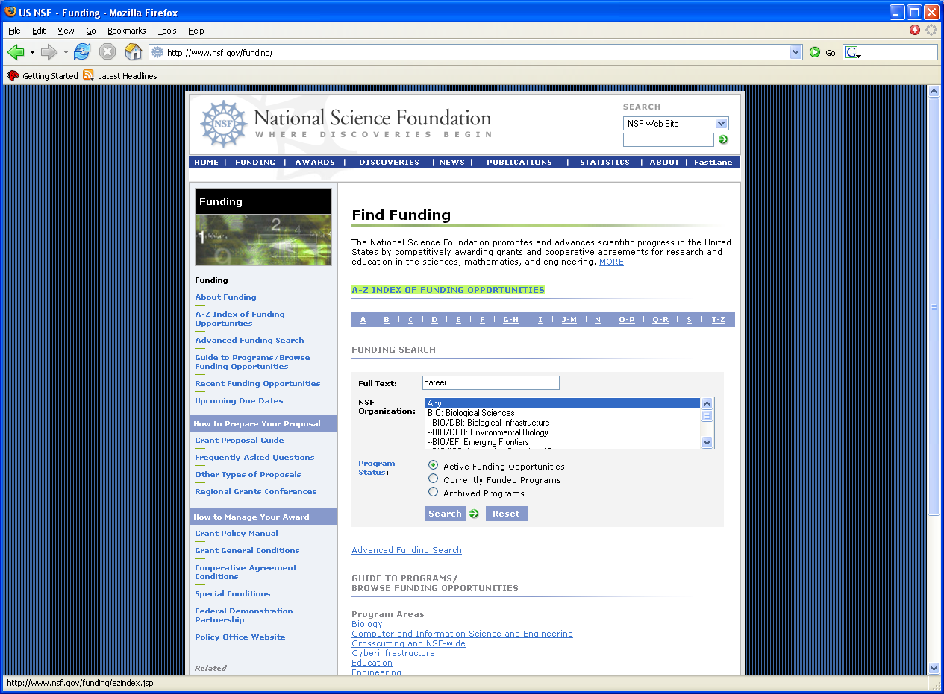
http://research.usc.edu/files/2011/05/funding_strategy_workshop.ppt

Slide 26
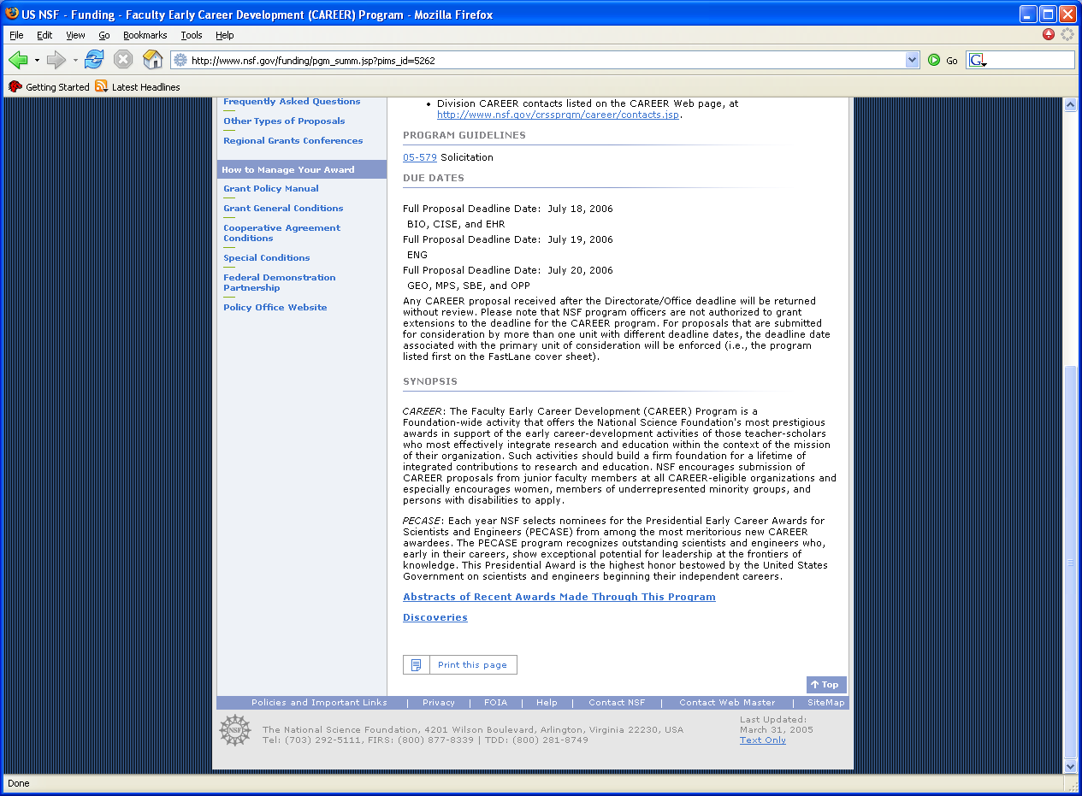

Slide 27
Summary Should do Exactly What is Asked
Project Summary:
Summarize the integrated education and research activities of the proposed CAREER project. Note that the Project Summary must clearly address in separate statements how the proposal meets both the Intellectual Merit and Broader Impact review criteria.
http://research.usc.edu/files/2011/05/funding_strategy_workshop.ppt

Slide 28
Project Description
Well-argued and specific proposal for activities that will, over a 5-year period, build a firm foundation for a lifetime of contributions to integrated research and educational activities in the context of the PI's organization. Note that the Project Description may not exceed 15 pages.
Should Include:
a description of the proposed research project, including preliminary supporting data where appropriate, specific objectives, methods and procedures to be used, and expected significance of the results;
a description of the proposed educational activities, including plans to evaluate their impact;
a description of how the research and educational activities are integrated with one another; and
results of prior NSF support, if applicable.

Slide 29
Education
Proposed education activities may be in a broad range of areas and may be directed to any level: K-12 students, undergraduates, graduate students, and/or the general public, but should be related to the proposed research.
Some examples are:
designing innovative courses or curricula;
supporting teacher preparation and enhancement; conducting outreach and mentoring activities to enhance scientific literacy or involve students from groups that have been traditionally underrepresented in science;
researching pedagogy or students' learning and conceptual development in the discipline; incorporating research activities into undergraduate courses;
linking education activities to industrial, international, or cross-disciplinary work;
and implementing innovative methods for evaluation and assessment.
http://research.usc.edu/files/2011/05/funding_strategy_workshop.ppt

Slide 30
Education
Education activities may also include designing new educational materials and practices or adapting and implementing effective educational materials and practices developed elsewhere. Such activities should be consistent with research and best practices in curriculum, pedagogy, and evaluation.
A helpful document for information on NSF programmatic goals for evaluating education activities is the NSF publication The 2002 User-Friendly Handbook for Project Evaluation (NSF 02-057).
http://research.usc.edu/files/2011/05/funding_strategy_workshop.ppt

Slide 31
Proposal Outline
Summary
Intellectual Merit
Broader Impact
Project Description
Introduction
Research Plan
Objectives
Review of prior research
Supporting data
Methods and procedures
Expected results
Education Plan
Activities
Assessment
Integration or Research and Education
Budget and Schedule
Conclusions
http://research.usc.edu/files/2011/05/funding_strategy_workshop.ppt

Slide 32
Intellectual Merit
How important is the proposed activity to advancing knowledge and understanding within its own field or across different fields?
How well qualified is the proposer (individual or team) to conduct the project? (If appropriate, the reviewer will comment on the quality of the prior work.)
To what extent does the proposed activity suggest and explore creative and original concepts?
How well conceived and organized is the proposed activity? Is there sufficient access to resources?
http://research.usc.edu/files/2011/05/funding_strategy_workshop.ppt

Slide 33
Broader Impacts
How well does the activity advance discovery and understanding while promoting teaching, training, and learning?
How well does the proposed activity broaden the participation of underrepresented groups (e.g., gender, ethnicity, disability, geographic, etc.)?
To what extent will it enhance the infrastructure for research and education, such as facilities, instrumentation, networks, and partnerships?
Will the results be disseminated broadly to enhance scientific and technological understanding?
What may be the benefits of the proposed activity to society?
http://research.usc.edu/files/2011/05/funding_strategy_workshop.ppt

Slide 34
Integration of Research and Education
One of the principal strategies in support of NSF's goals is to foster integration of research and education through the programs, projects, and activities it supports at academic and research institutions.
These institutions provide abundant opportunities where individuals may concurrently assume responsibilities as researchers, educators, and students and where all can engage in joint efforts that infuse education with the excitement of discovery and enrich research through the diversity of learning perspectives.
http://research.usc.edu/files/2011/05/funding_strategy_workshop.ppt

Slide 35
Diversity
Broadening opportunities and enabling the participation of all citizens -- women and men, underrepresented minorities, and persons with disabilities -- is essential to the health and vitality of science and engineering.
NSF is committed to this principle of diversity and deems it central to the programs, projects, and activities it considers and supports.
http://research.usc.edu/files/2011/05/funding_strategy_workshop.ppt

Slide 36


And remember.. choose to be happy, always.
https://www.slideshare.net/MichelleLynCruz/trello-73198801

